Slide 1
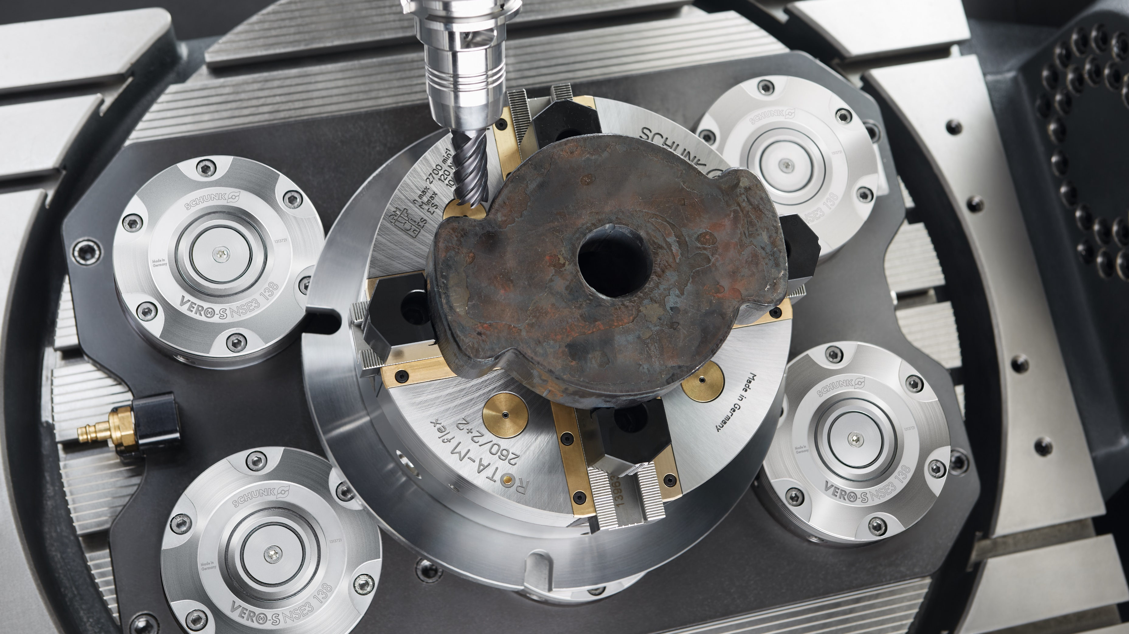

ROTA-M flex 2+2
ROTA-ML flex 2+2

Slide 2
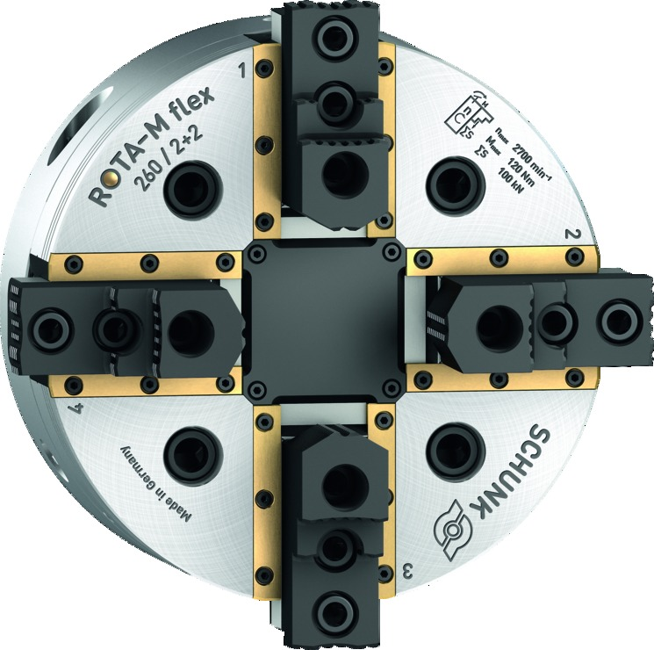
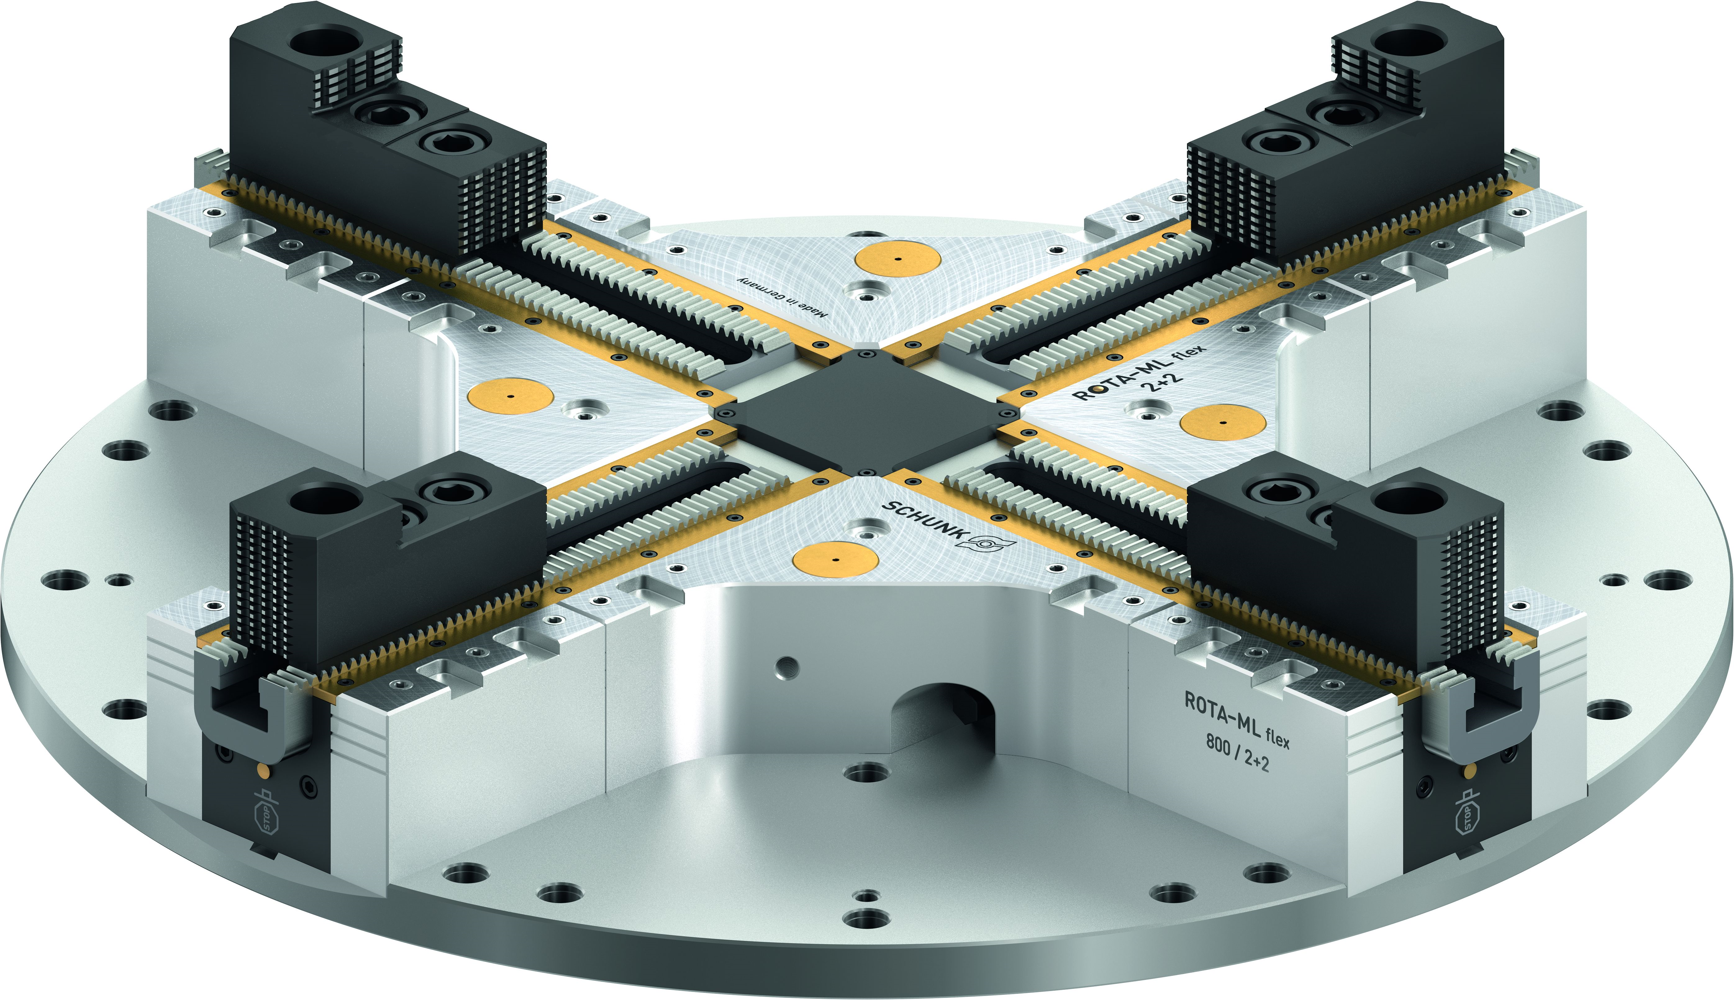

Lathe Chucks
ROTA-M flex 2+2
ROTA-ML flex 2+2
Extremely flexible 4-jaw manual lathe chuck

Slide 3
Highlights I Field of application
ROTA-M flex 2+2 I ROTA-ML flex 2+2
Extremely flexible clamping system for gripping any workpieces
Patented drive concept with compensation mechanism
Sealed manual lathe chuck
Mill/turn machines
Storage solutions

Slide 4

From size 500
ROTA-M flex 2+2 I ROTA-ML flex 2+2
Facelift of the ML variants from size 500: Significant reduction in lining height and weight
For clamping round, cubic or geometrically bulky workpieces
Easy and efficient retrofitting also to 2-jaw chuck and fixed jaw clamp

Slide 5
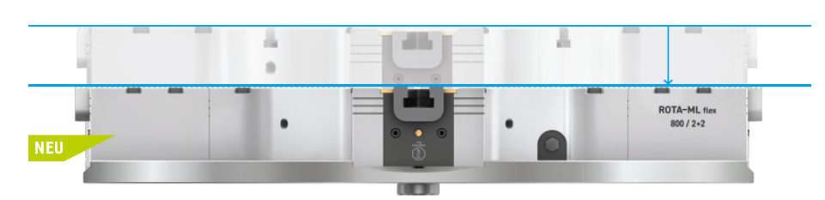
Significant weight reduction in the new generation – Facelift ROTA-ML flex 2+2
ROTA-M flex 2+2 I ROTA-ML flex 2+2
up to 30% smaller
up to 40% less weight
machining of larger and heavier workpieces possible
NEW

Slide 6
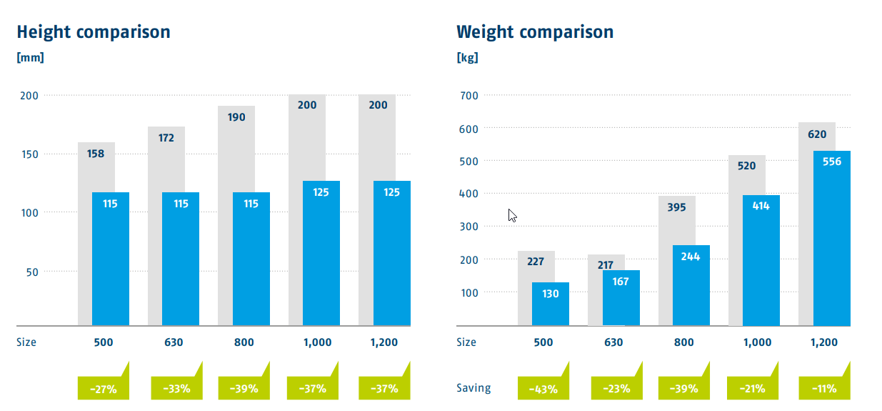
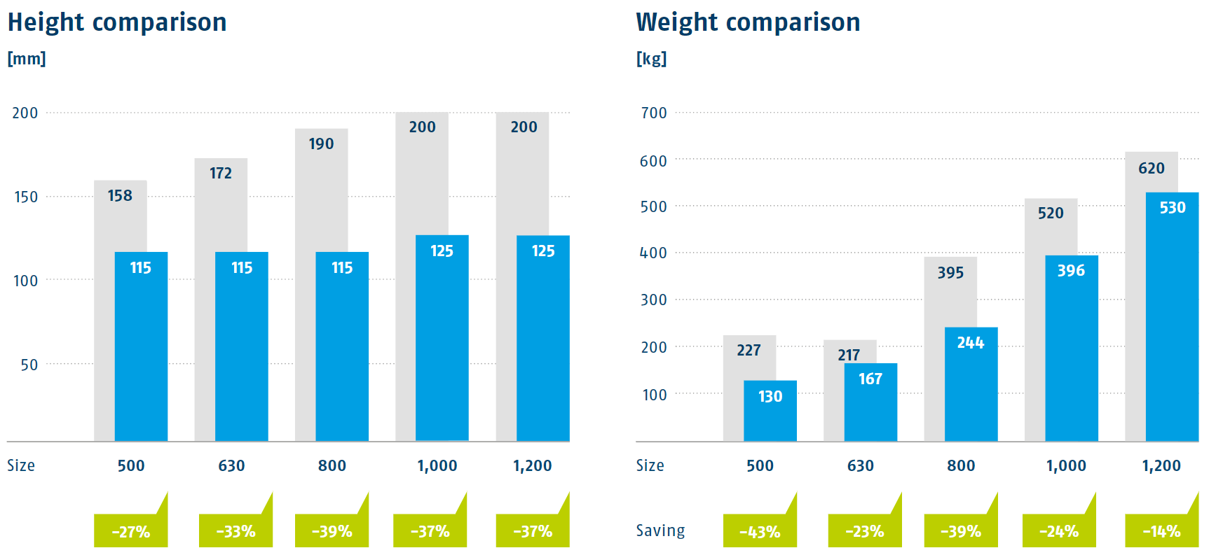
Significant weight reduction in the new generation – Facelift ROTA-ML flex 2+2
ROTA-M flex 2+2 I ROTA-ML flex 2+2

Slide 7
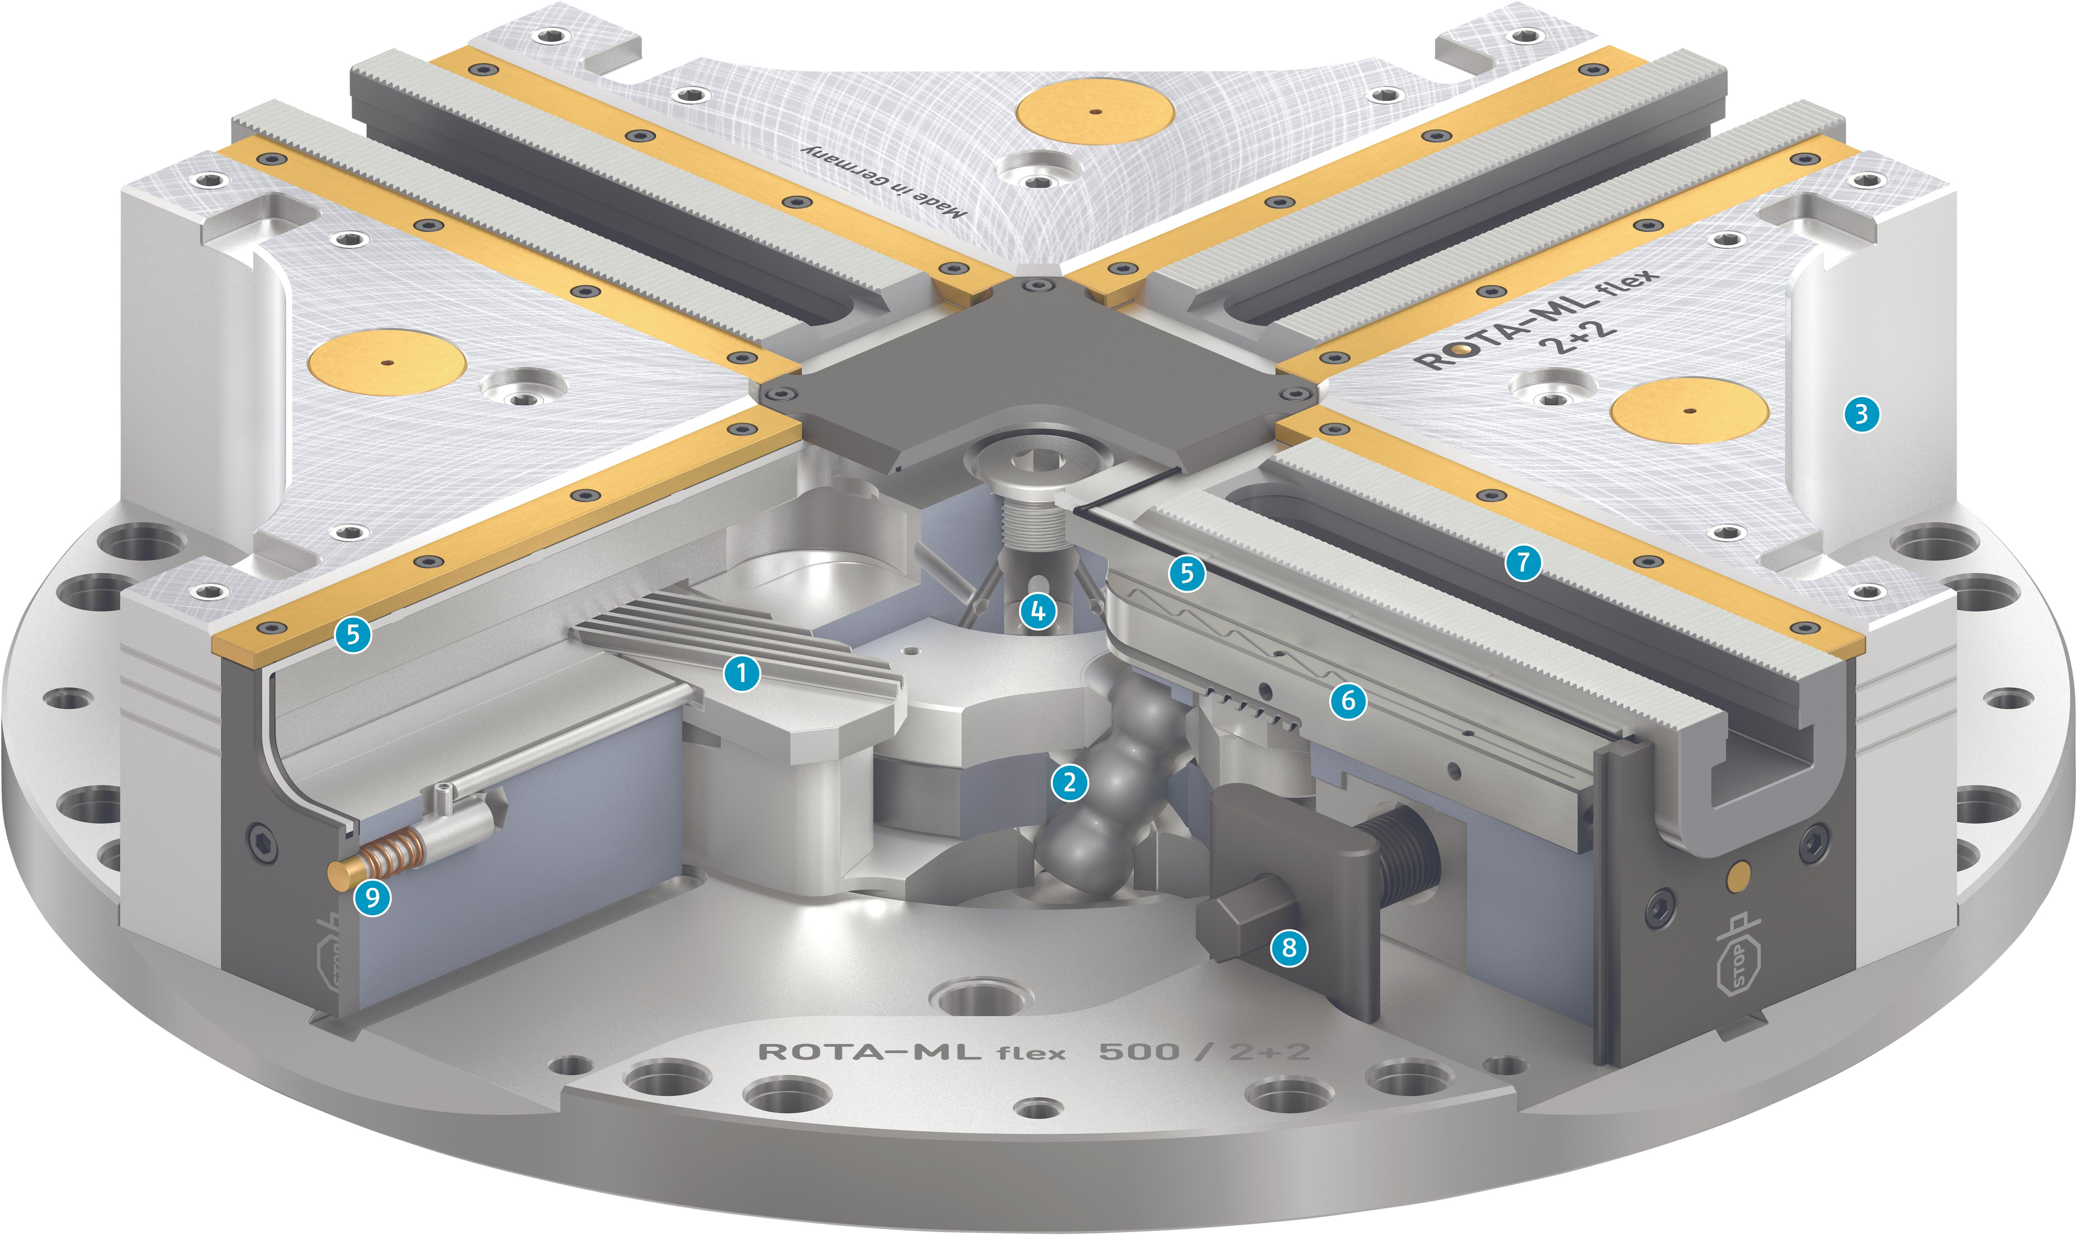
Function
ROTA-M flex 2+2 I ROTA-ML flex 2+2
Wedge bar actuation system
Patented drive concept
Hardened and extremely rigid base body
Central lubrication system with grease reservoir
Sealing the lathe chuck
Long jaw guidance
Standard jaw interface
Operation via hexagon connection
Indicator pin

Slide 8
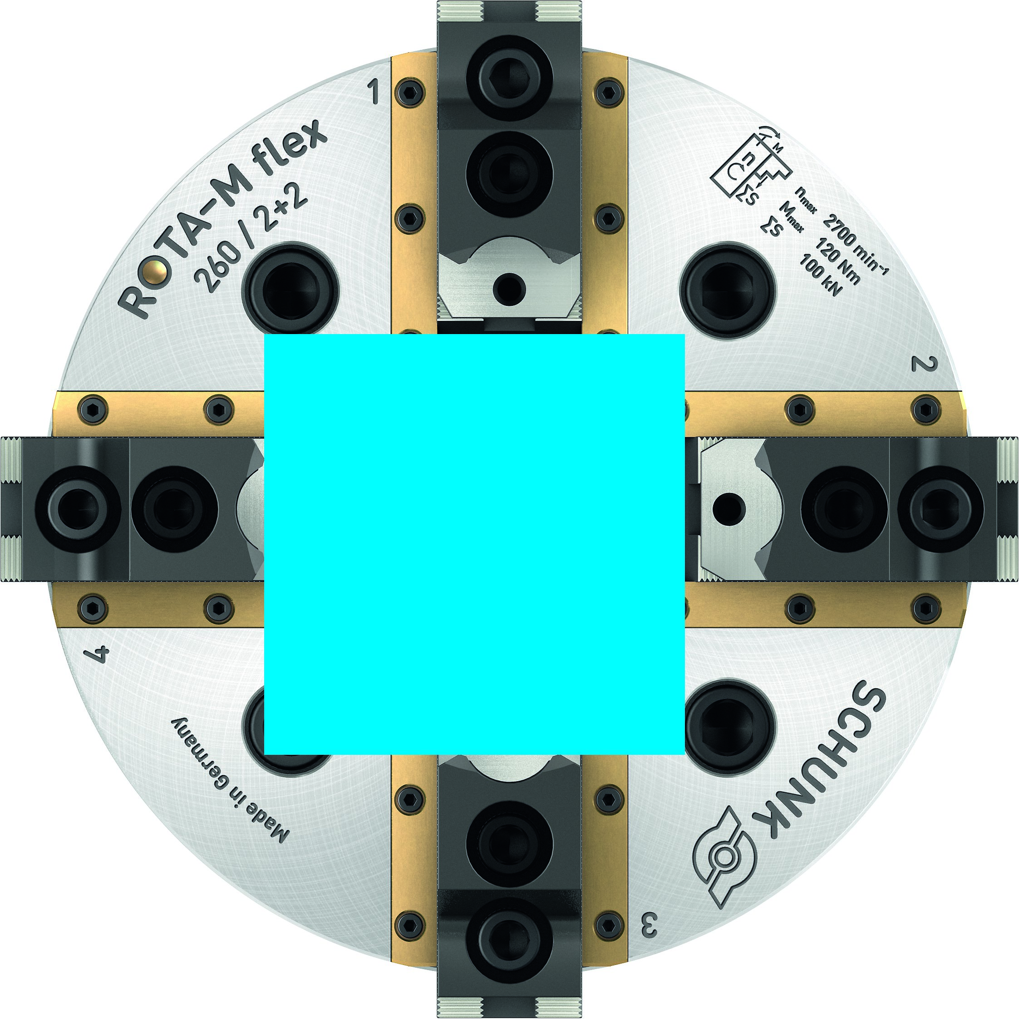
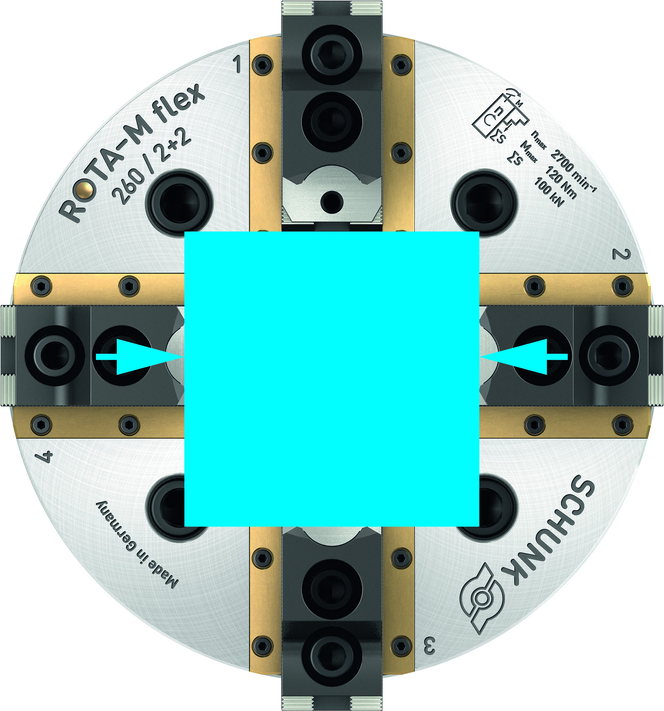
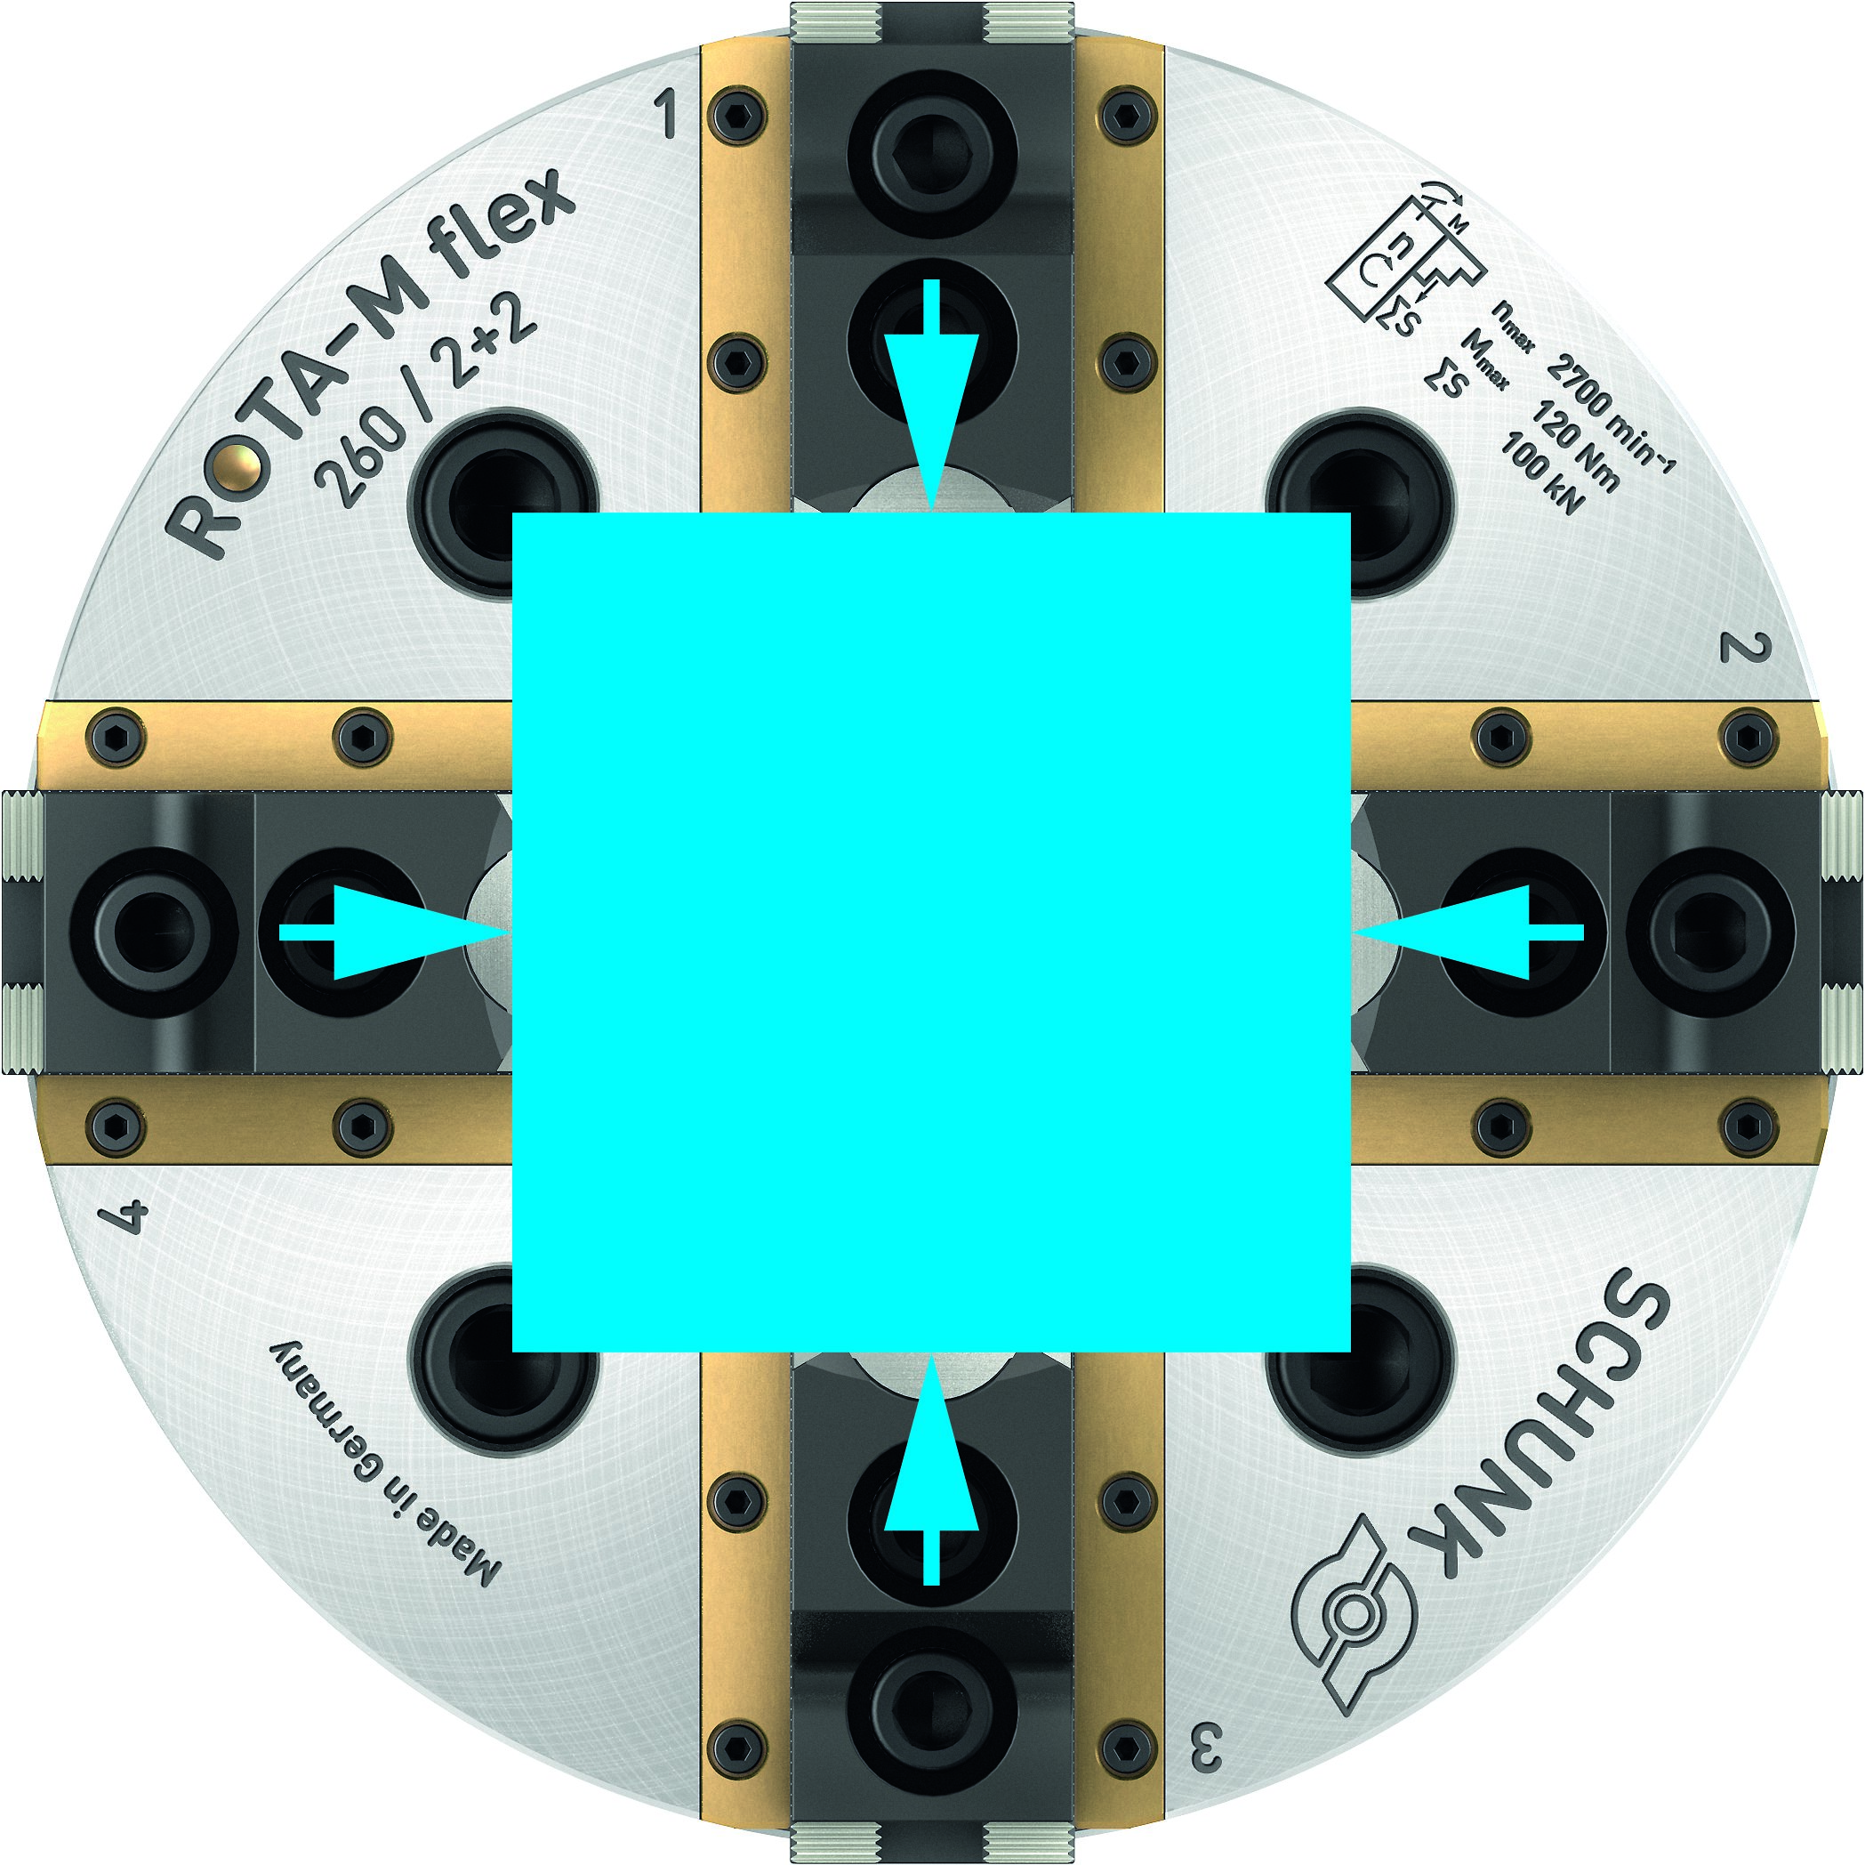
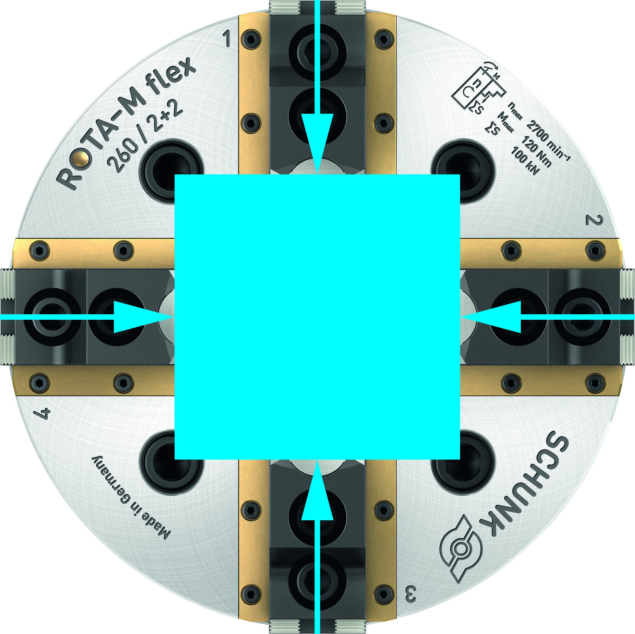
Function
ROTA-M flex 2+2 I ROTA-ML flex 2+2
Insert the workpiece
Round, cubic or geometrically unshaped parts can be inserted in open state.
Install the first pair of jaws
By actuating the manual lathe chuck, the first pair of jaws contacts the workpiece. The workpiece is now centered in this plane.
Install the second pair of jaws
During further actuation, the second pair of jaws also contacts the workpiece and moves the workpiece in this plane to the center.
Clamp the workpiece
If both pairs of jaws are in contact with the workpiece, the workpiece is clamped evenly and centrally with the fully clamping force.

Slide 9
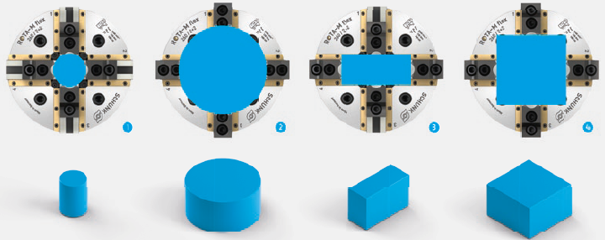
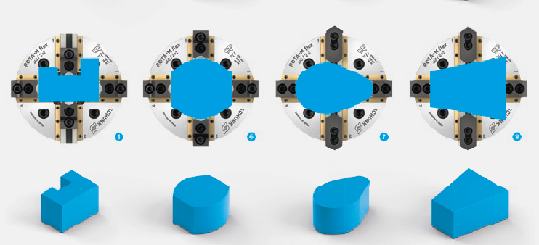
Maximum flexibility
ROTA-M flex 2+2 I ROTA-ML flex 2+2
small workpieces
large workpieces
rectangular workpieces
square workpieces
free-form parts
semicircular and angular workpieces
cams
inclined workpieces

Slide 10
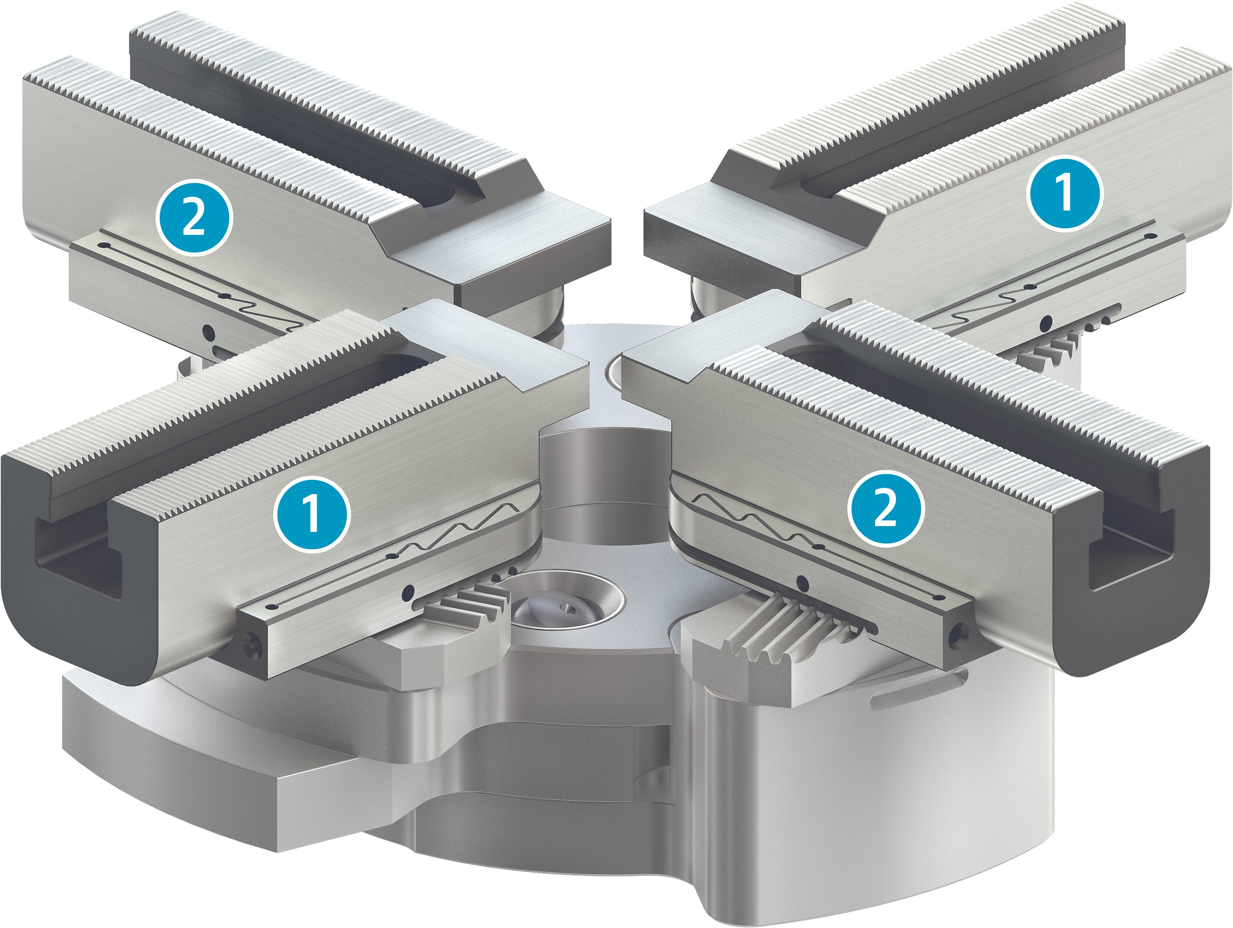
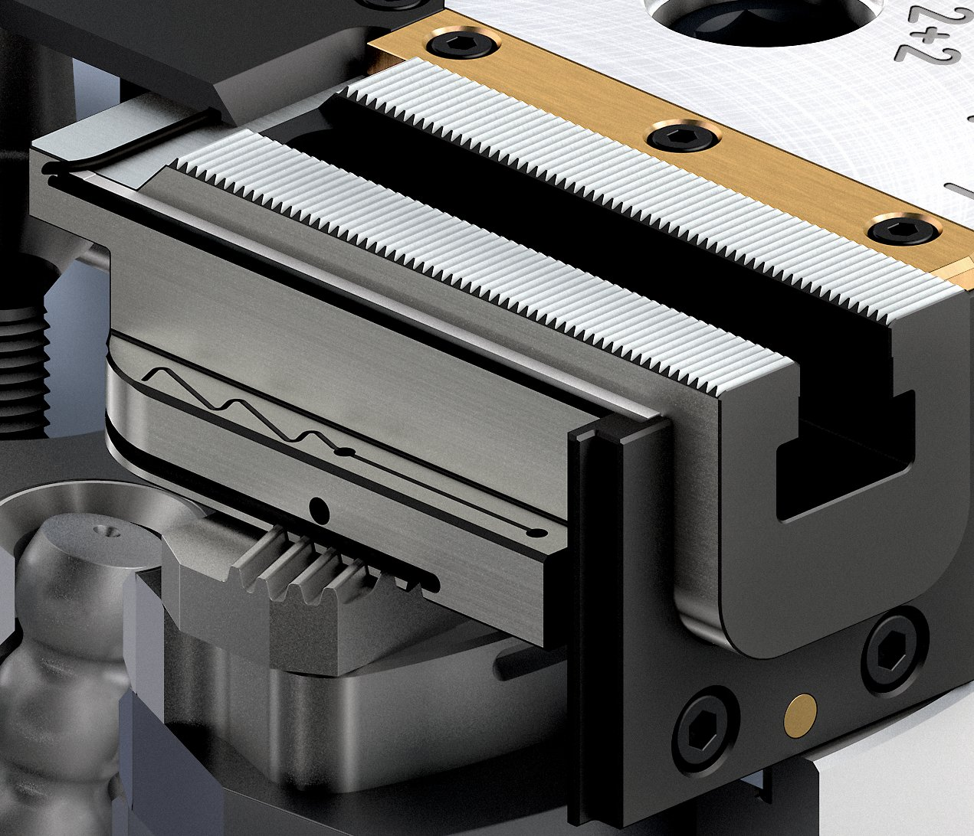
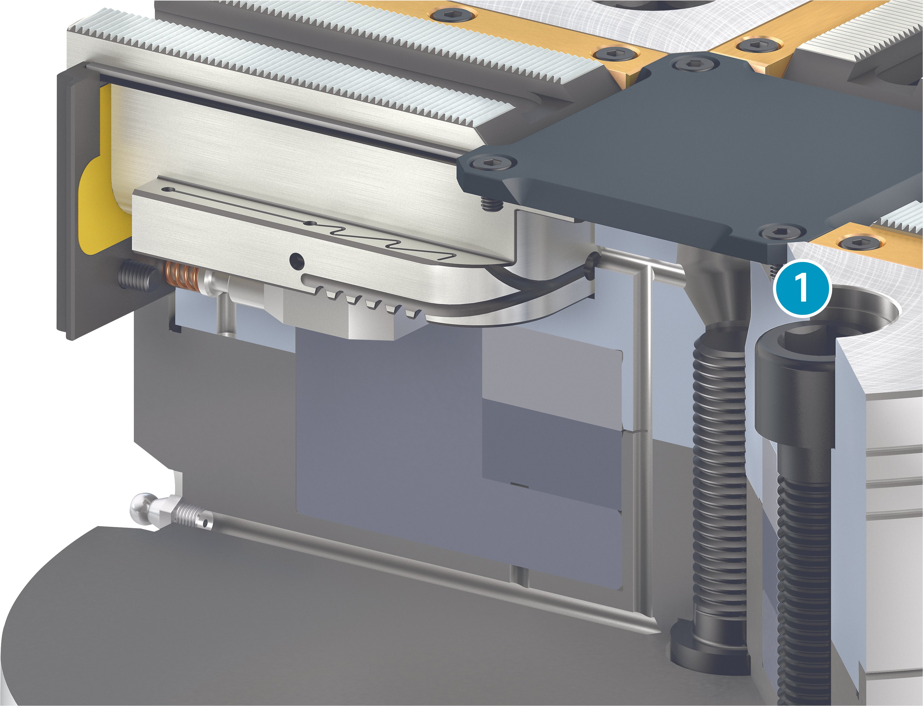
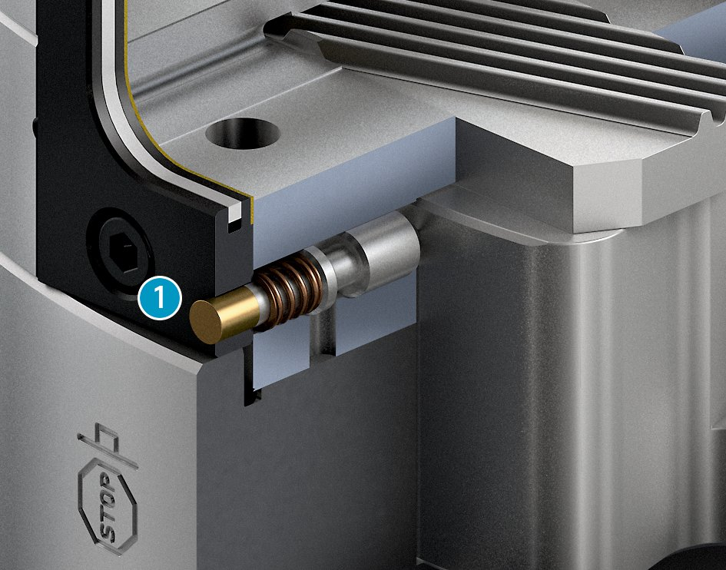
Highlights
ROTA-M flex 2+2 I ROTA-ML flex 2+2
Compensating workpiece clamping
First pair of jaws
Second pair of jaws
Sealed manual lathe chuck
Central lubrication system with grease reservoir
Grease reservoir
Visual clamping release
Indicator pin

Slide 11
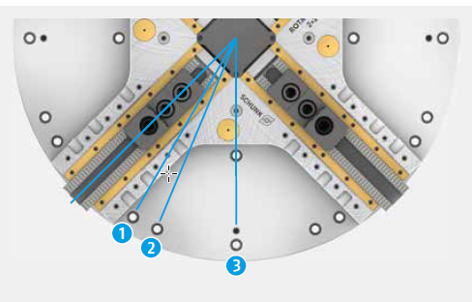
Highlights
ROTA-M flex 2+2 I ROTA-ML flex 2+2
Various mounting preperation in Standard
22,5° star T-nut design
30° star T-nut design
45° star T-nut design

Slide 12
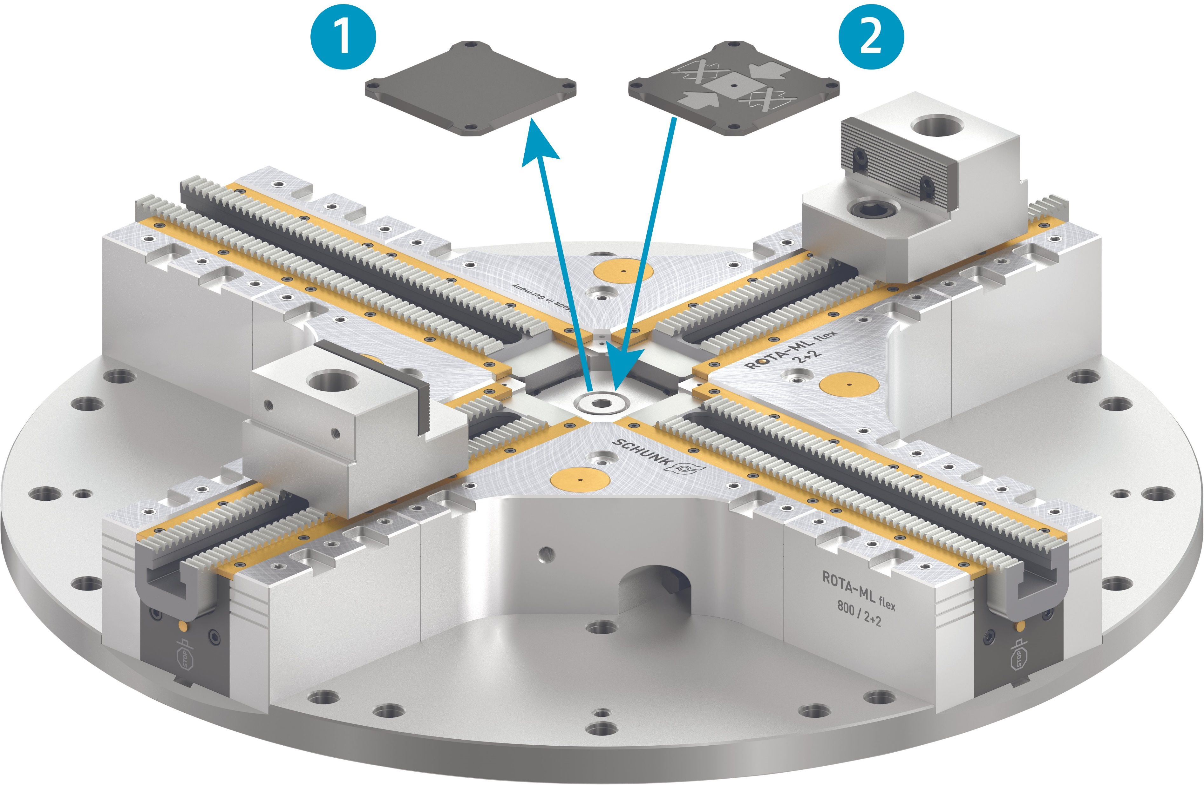
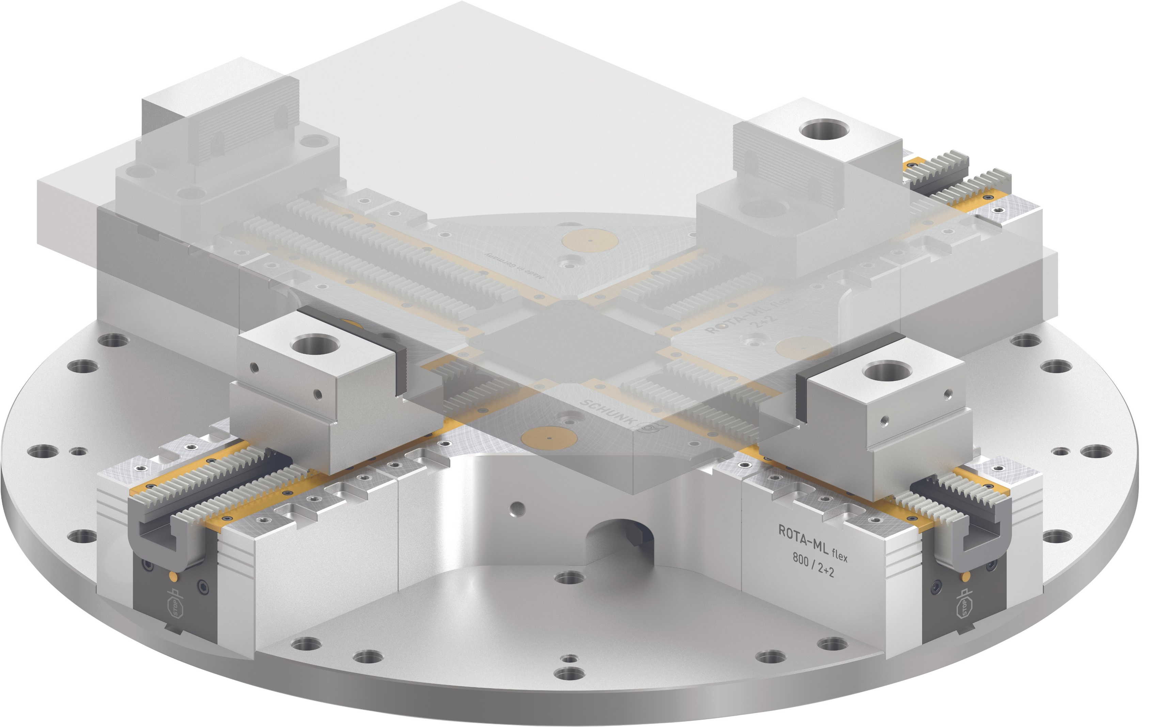
Highlights
ROTA-M flex 2+2 I ROTA-ML flex 2+2
Weight-reduced design
2-jaw clamping
Locking cover without stop
Locking cover with stop
Console clamping

Slide 13
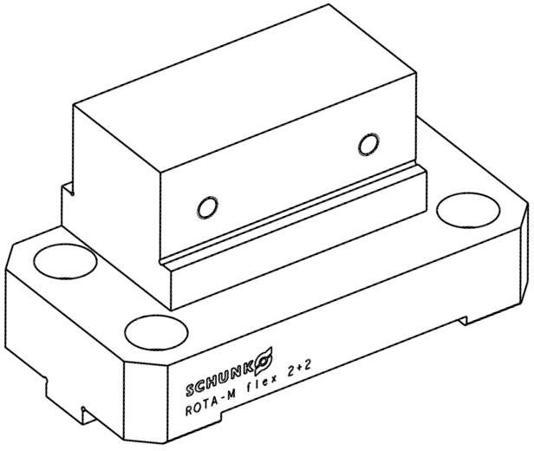


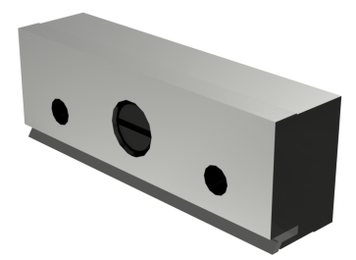
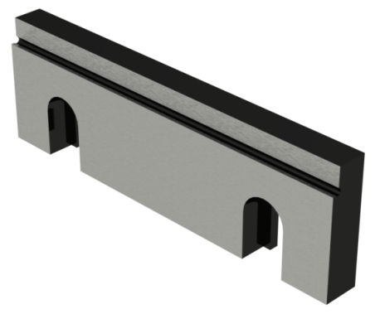
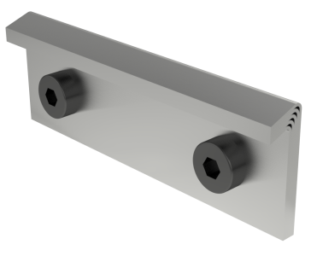
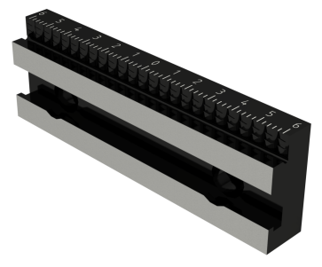

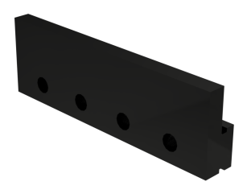
Top console jaws
ROTA-M flex 2+2 I ROTA-ML flex 2+2
One type of fixed console jaws SKB-F 100 (ID 1572658) suitable for all ROTA-ML flex 2+2 facelift chucks

Slide 14
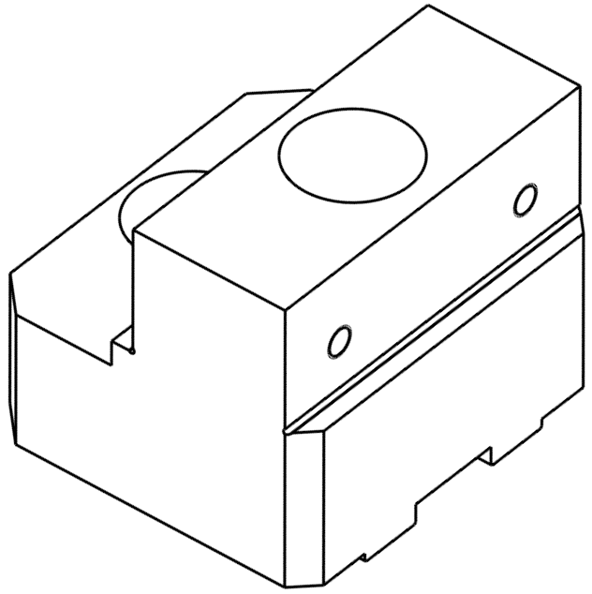
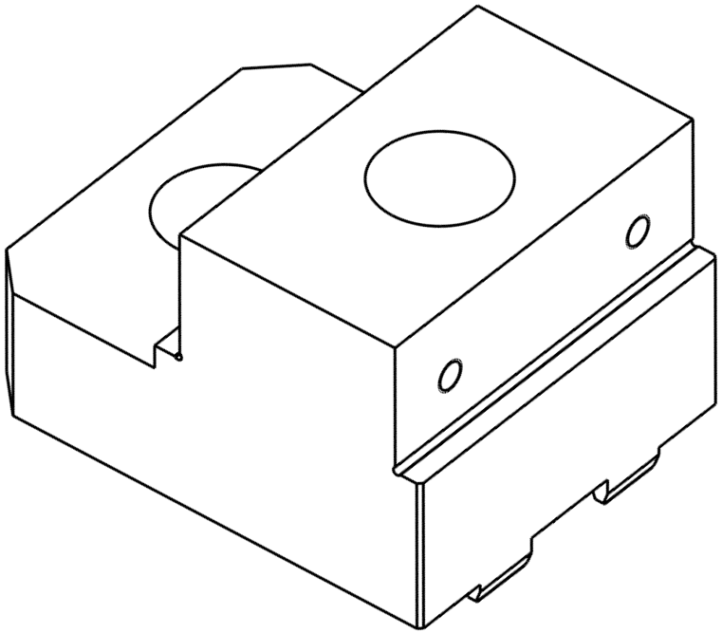
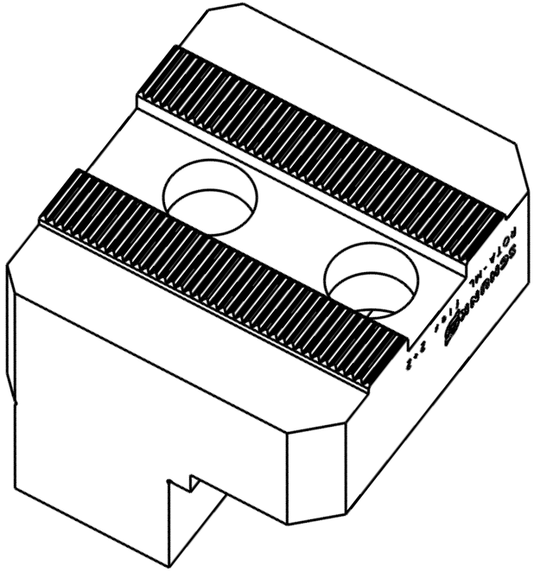
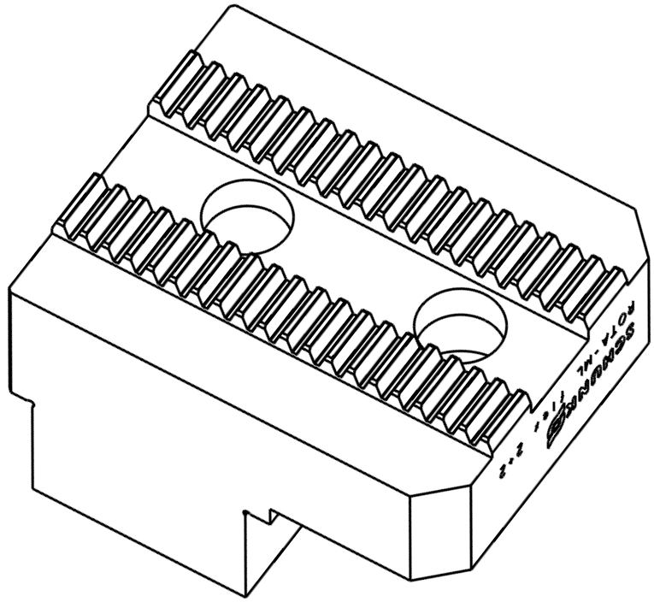
Top console jaws
ROTA-M flex 2+2 I ROTA-ML flex 2+2
Two types of movable console jaws SKB 100
SKB-SV90° 100 (ID 1572700) suitable for ROTA-ML flex 2+2 500 and 630 with fine serration 3/32" x 90°
SKB-M2 100 (ID 1572701) suitable for ROTA-ML flex 2+2 800, 1000 and 1200 with serration Module 2

Slide 15
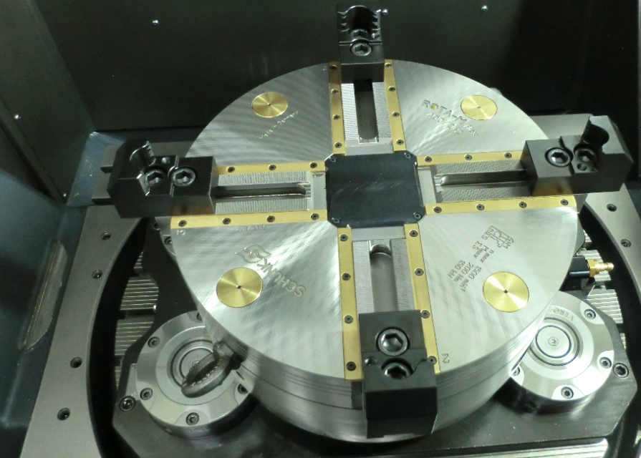

Example of application
ROTA-M flex 2+2 I ROTA-ML flex 2+2
ROTA-M flex 2+2 400 on a DMG Mori DMU 75
Production of pallets in 2 setups
Compensating workpiece clamping of blank plate in claw jaws in OP10 in 2+2 jaw chuck
OP20: clamping on machined surface with soft jaws

Slide 16
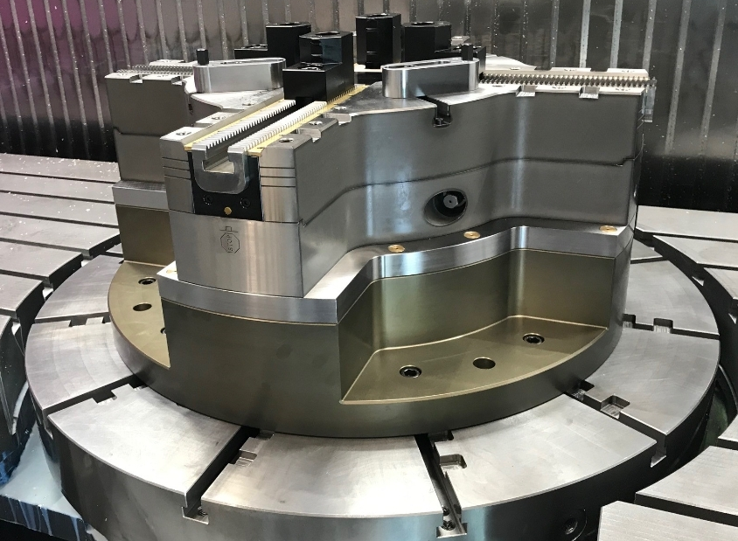
Example of application
ROTA-M flex 2+2 I ROTA-ML flex 2+2
ROTA-ML flex 2+2 800 on the rotary table of an Ibarmia ZVH 58
For accessibility, a special console was manufactured by the customer at a height of 150 mm
With the 4-jaw adapter, a clamping force measurement can be carried out with the IFT on a 2+2 jaw chuck

Slide 17
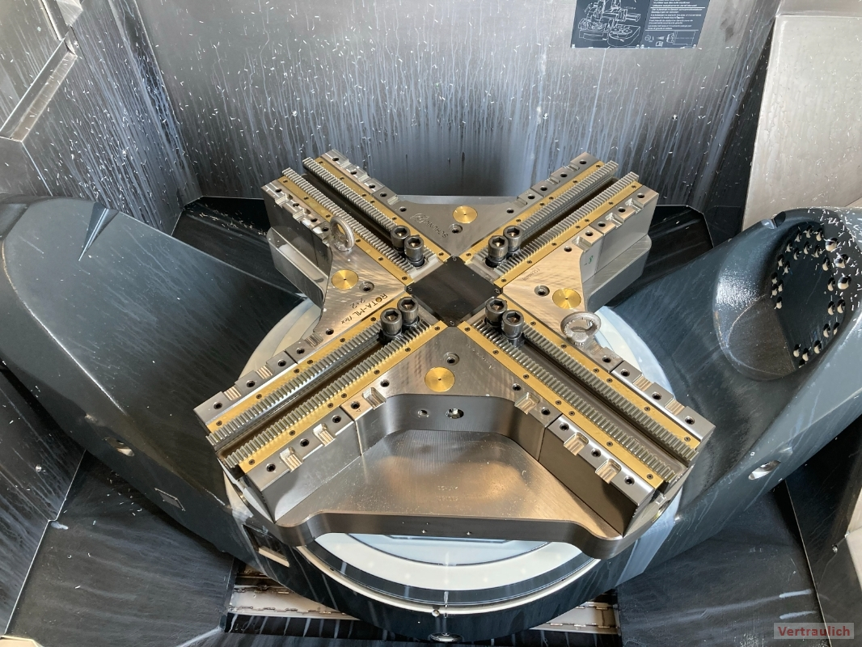
Example of applicaton
ROTA-M flex 2+2 I ROTA-ML flex 2+2
ROTA-ML flex 2+2 800 to DMG MORI DMC 85 mB FD with Integral pallet
Clamping of cubic and rotationally symmetrical components
The console plate of the ROTA-ML flex also serves as a machine pallet with clamping cones on the underside. The advantage is the reduction in height and weight.
For milling on a 5-axis machine

Slide 18
Technical data
ROTA-M flex 2+2 I ROTA-ML flex 2+2
Description | Max. RPM | Max. clamping force | Max. torque | Stroke/jaw | Compensation stroke/jaw
 | [min-¹ ] | [kN] | [Nm] | [mm] | [mm]
ROTA-M flex 2+2 260 | 2700 | 100 | 120 | 9.5 | 5.1
ROTA-M flex 2+2 315 | 2200 | 100 | 120 | 9.5 | 5.1
ROTA-M flex 2+2 400 | 1500 | 150 | 200 | 14.5 | 7.9
ROTA-ML flex 2+2 500 | 1500 | 180 | 210 | 17.3 | 12
ROTA-ML flex 2+2 630 | 1300 | 180 | 210 | 17.3 | 12
ROTA-ML flex 2+2 800 | 1100 | 180 | 210 | 17.3 | 12
ROTA-ML flex 2+2 1000 | 850 | 180 | 210 | 17.3 | 12
ROTA-ML flex 2+2 1200 | 750 | 180 | 210 | 17.3 | 12

