Slide 1

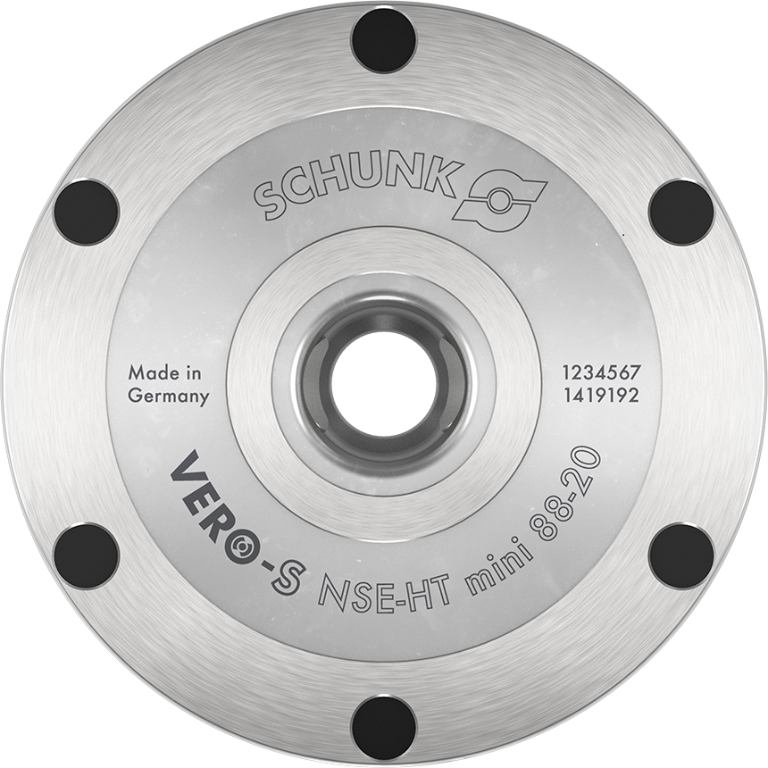
VERO-S NSE-HT mini
The proven Quick-change Pallet System I Heat-resistant up to + 200 °C

Slide 2
VERO-S NSE-HT mini
General information
Suitable for high temperatures
Excellent thermal conductivity
No cooling necessary for unlocking
Positioning via short taper
Turbo integrated by default
Low height
Form-fit, self-retained locking
The modules are stainless and completely sealed
One consistent clamping pin size for all NSE-mini-modules
All modules can be operated with a system pressure of 6 bar
Suitable for actuation with inert gas

Slide 3
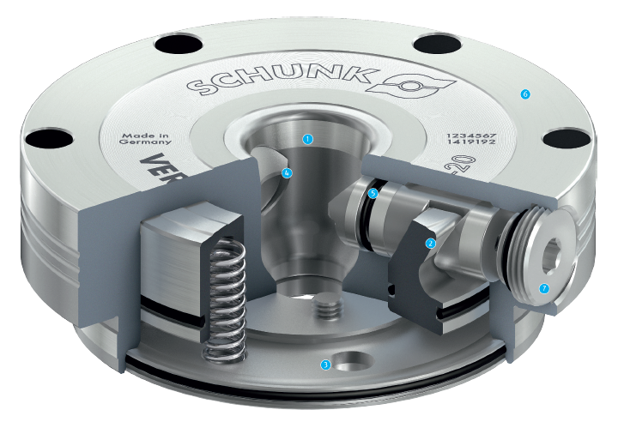
VERO-S NSE-HT mini
Functional diagram
High-precision short taper centering
Wedge hook drive
Turbo function
Large surfaces
Completely sealed system
Large flat surface
Locking screw
1
2
6
3
1
4
4
5
5
6
2
7
7
3

Slide 4
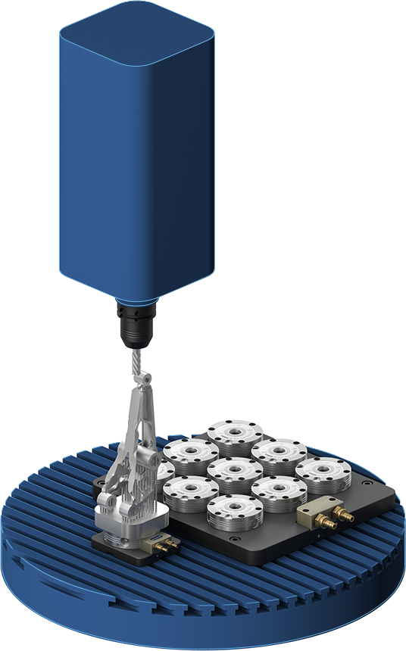
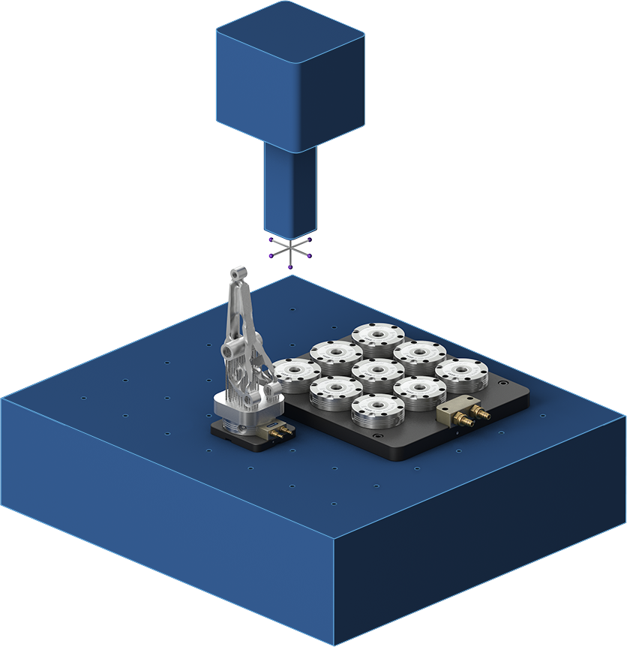
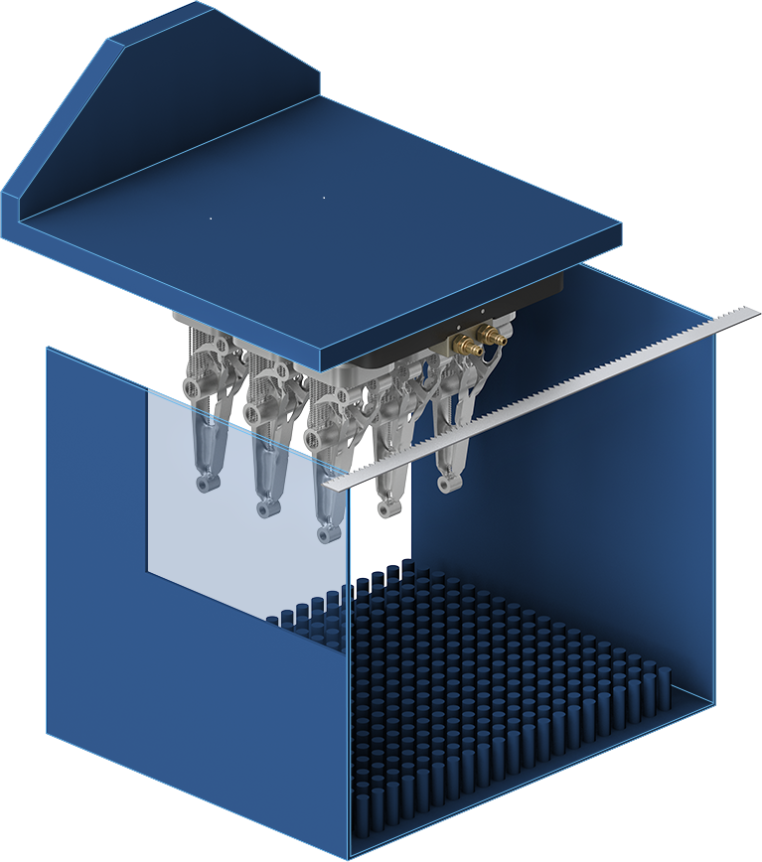
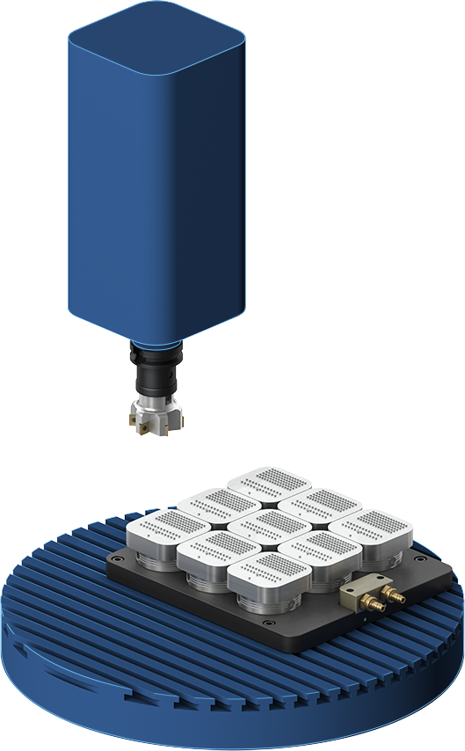
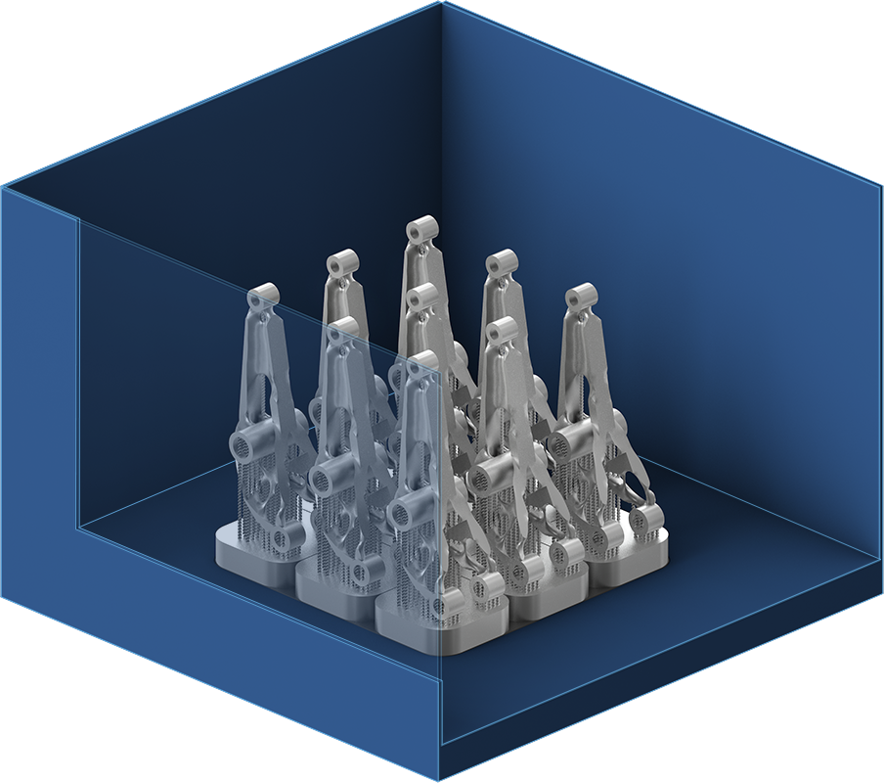
VERO-S NSE-HT mini
Monolithic manufacturing process
1. Manufacture additives
The workpieces are „printed“ directly on the substrate plate. Clamping modules with anti-twist protection enable the use of island substrate plates, which enable 5-sided post-processing.
2. Machining
Manufacture of functional surfaces and fits on a milling machine. The clamping station NSL mini 100-25-V1 can be used to clamping island substrates.
3. Measure up
Check the dimensional accuracy of the workpiece. The island substrate plates can be clamped on the clamping station NSL mini 100-25-V1.
4. Separate
Separating the workpieces from the substrate plates on a band saw. With a clamping station with 9 pieces NSE mini 90-25-V1, all workpieces can be separated from the substrate plates at once.
5. Machining
Joint milling of the island substrate plates on a 9-way clamping station for the next use. Joint milling over achieves optimal results with the same height, perfect preparation for the next construction process.

Slide 5

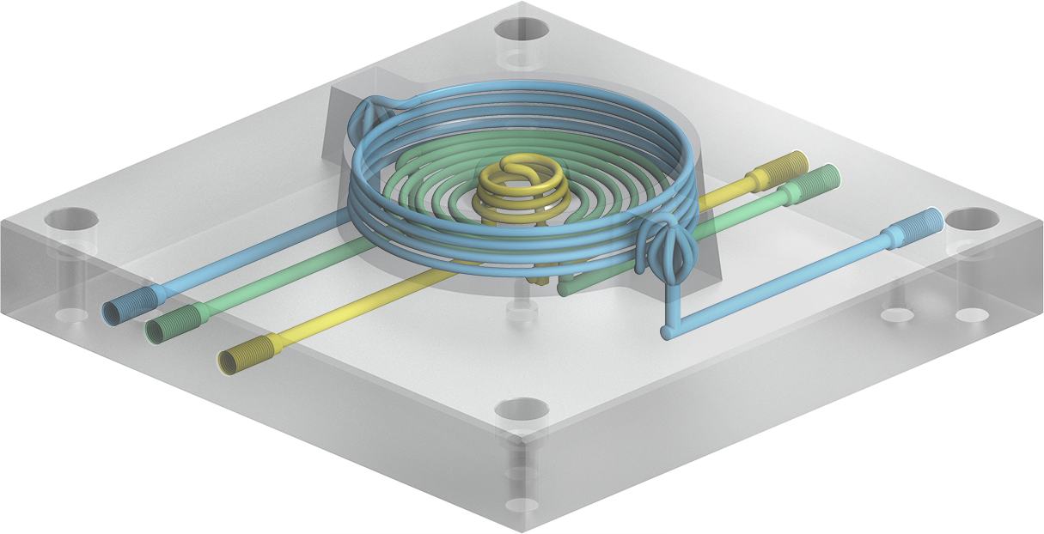
VERO-S NSE-HT mini
Hybrid workpieces – the best out of both worlds
Less costs
The advantages of both technologies are fully exploited through the conventional production of simple workpiece parts and the additive production of complex geometries.
Optimal cooling
In additive manufacturing, the cooling channels can be designed to be particularly close to the contour, which is ideal for injection molding.
More productivity
Cooling and processing times can be reduced considerably.

Slide 6
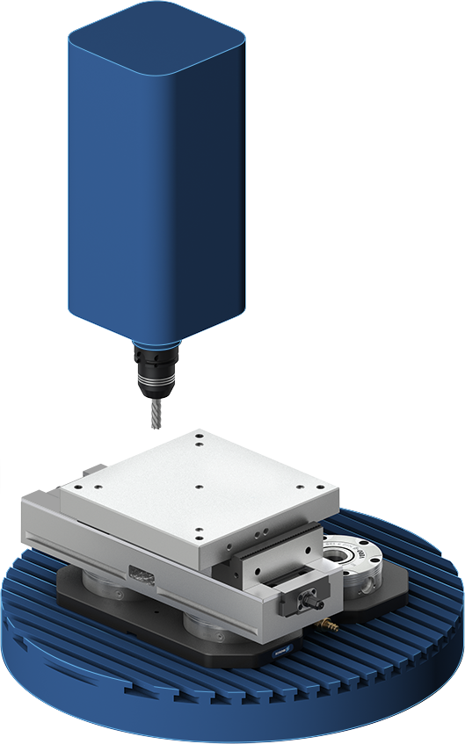
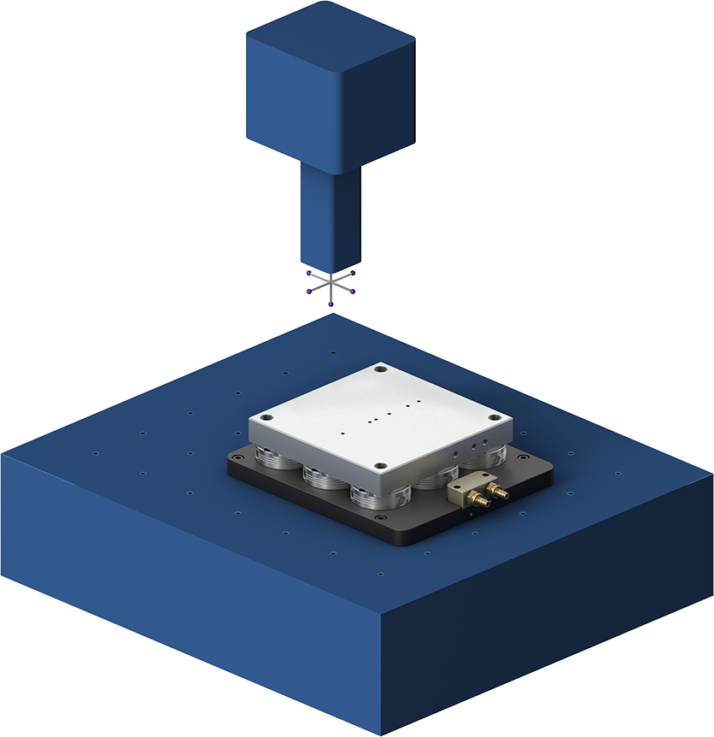
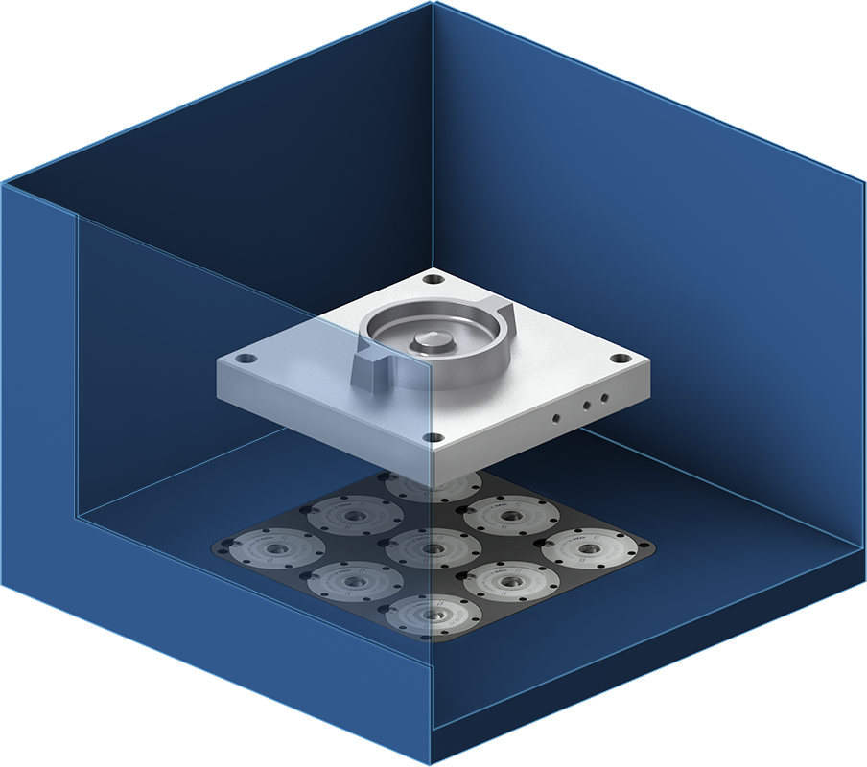
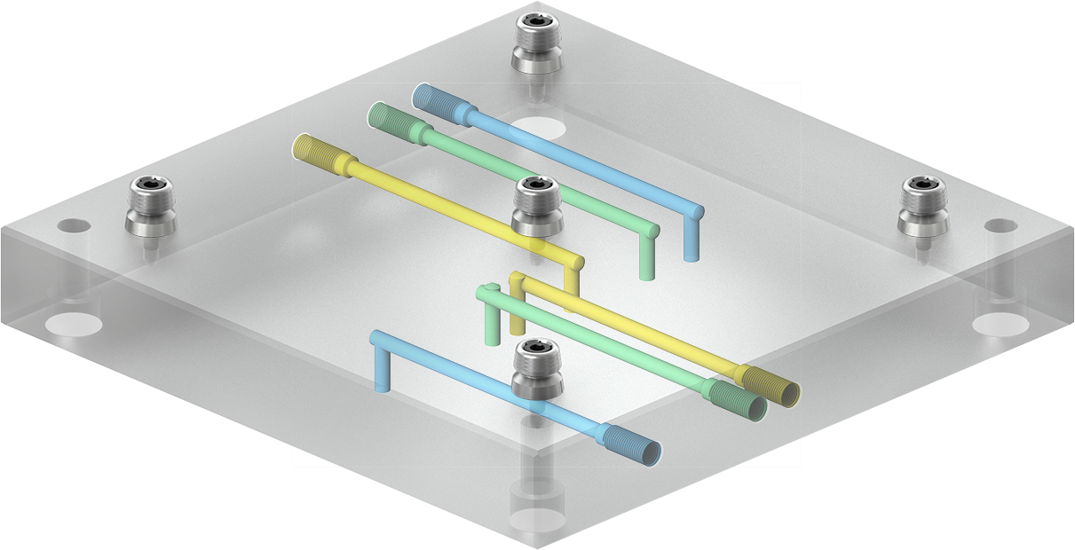
VERO-S NSE-HT mini
Hybrid manufacturing process
1. Machining & assembling
The hybrid blank is manufactured conventionally, then the clamping bolts are mounted directly on the hybrid blank. With an A-bolt in the center, the thermal zero point can be places in the center.
2. Measure
Offset measurement parallel to the main time can be reliably carried out with a measuring machine. The offset values can be adopted in the AM machine. Time-consuming measurement processes that are linked to the AM machine are no longer necessary.
3. Manufacturing additive
The complex part of the workpiece is additively „printed“ on the hybrid blank.

Slide 7
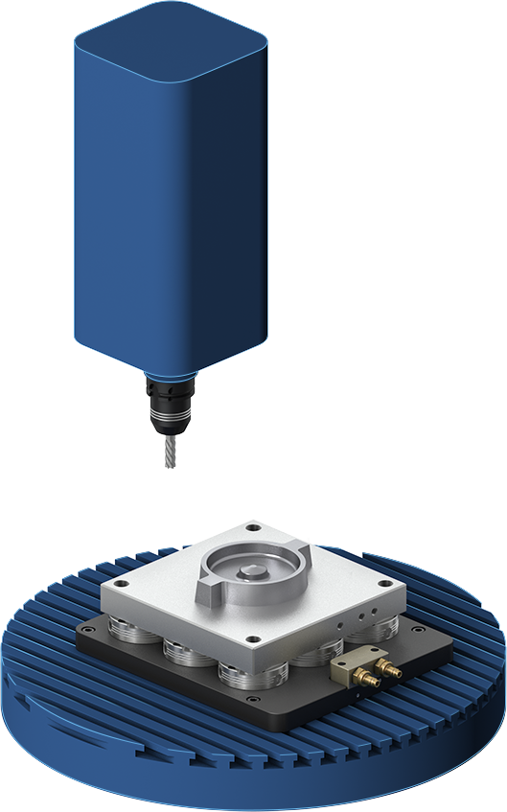
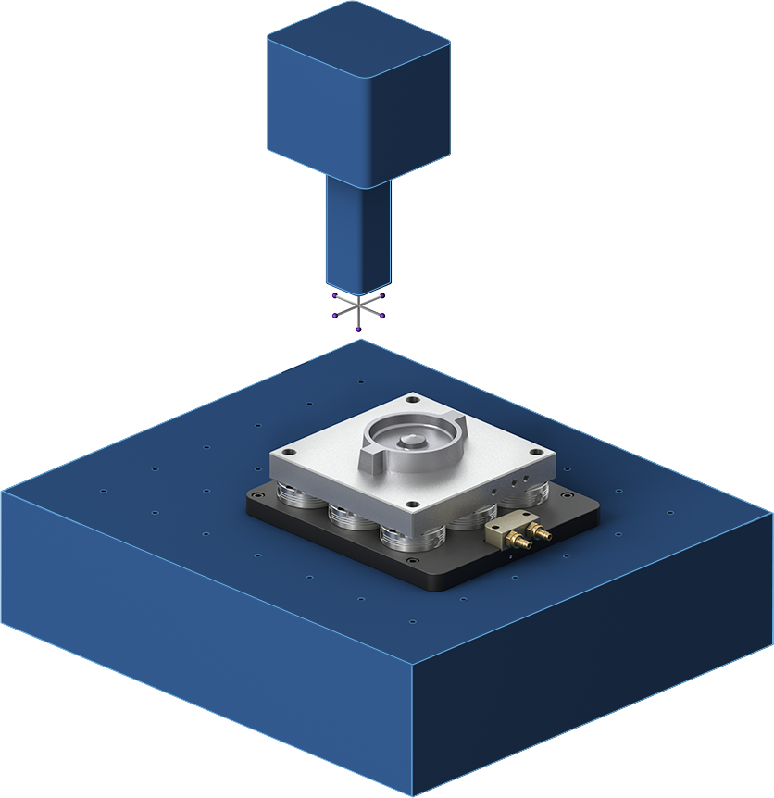
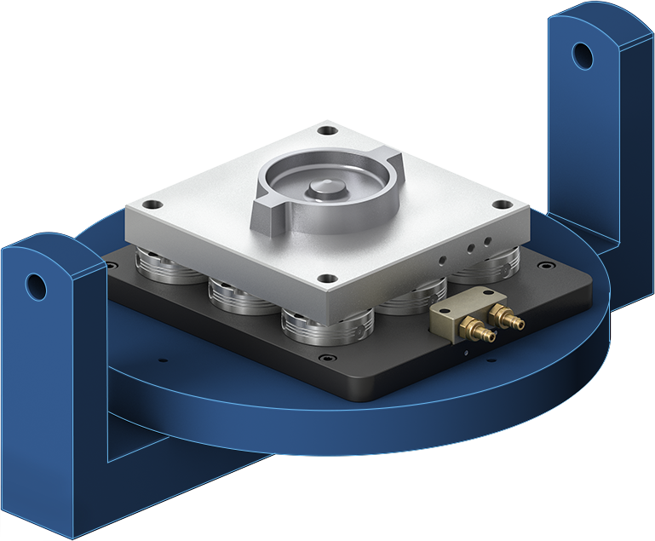
VERO-S NSE-HT mini
Hybrid manufacturing process
4. Depowder
Cooling channels and undercuts are de-powdered on a de-powdering machine.
5. Machining
Finishing the surface and manufacturing of functional surfaces.
6. Measure
Final measurement of the workpiece. The clamping bolts can then be removed. The workpiece is ready.

Slide 8
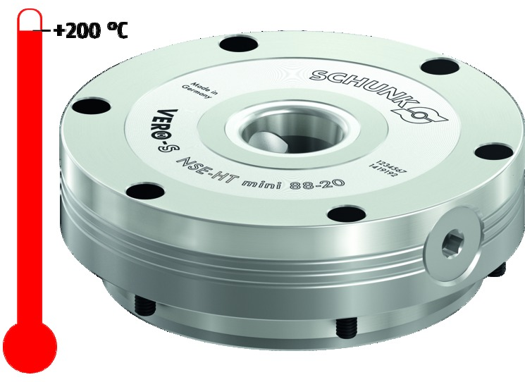
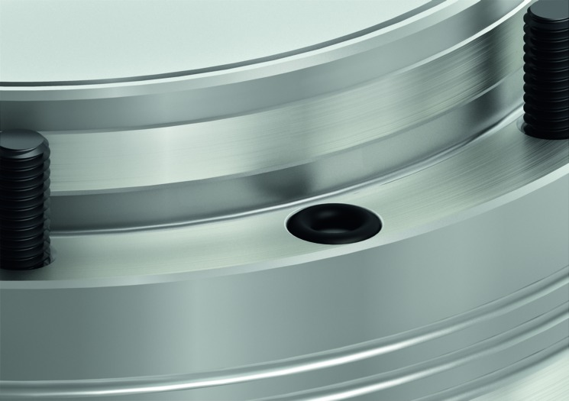
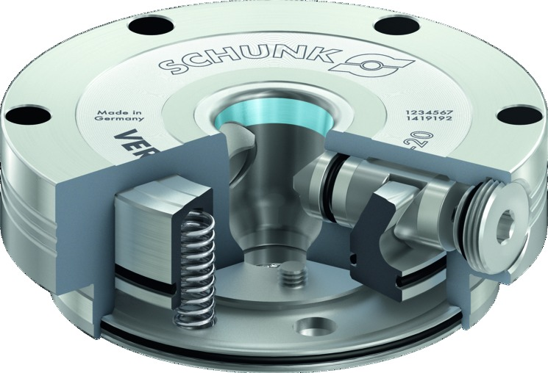
VERO-S-HT mini
Highlights
High-temperature resistant
Especially for applications with high temperatures. Ensuring smooth actuation of the module up to an operating temperature of 200 °C. Your advantage: Due to the cooling process, the module can be actuated directly without any loss of time.
Control of the quick-change pallet system
The modules are actuated via bottom air connections. It can be operated with inert gas, so that no separate compressed air supply is required in the area of the additive machines.
Centering via short taper
The precise short taper centering combined with the form-fit and self-retaining locking characterizes the SCHUNK quick-change pallet system.

Slide 9
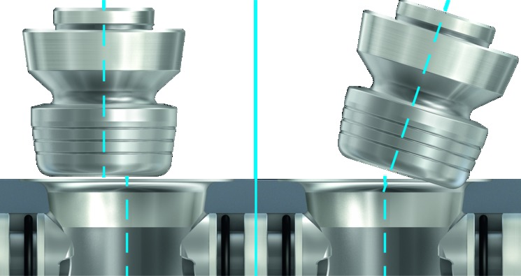
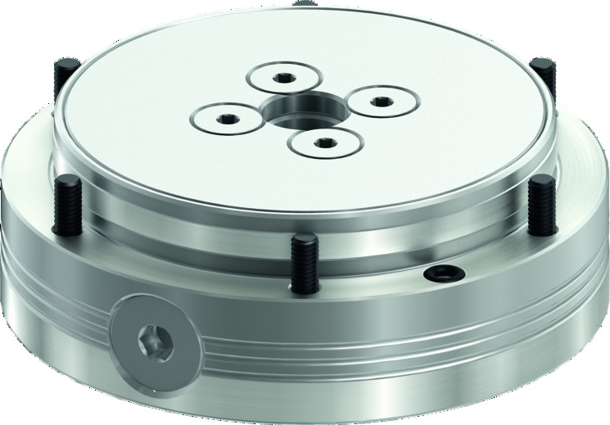
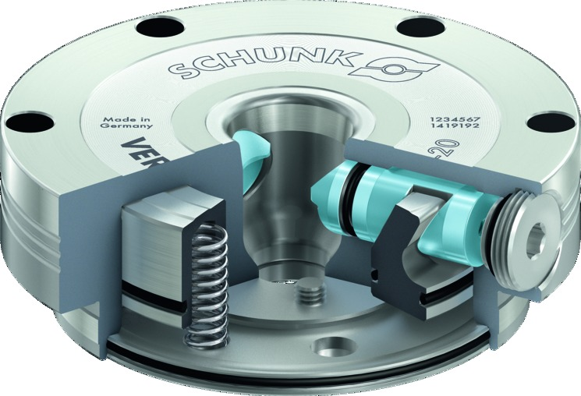
VERO-S-HT mini
Highlights
Locking via clamping slides
Large contact surfaces between clamping slides and clamping pin ensure a low surface pressure, resulting in a long service life.
Easy positioning – more user-friendly
Entry radii on the clamping pin enable quick and safe joining even at a tilt angle and eccentricity. Benefit: more user-friendly for manual and automated loading.
Module completely sealed
The cover plate at the lower piston chamber seals the system off completely. Your advantage: no penetration of chips, dirt or coolant.

Slide 10
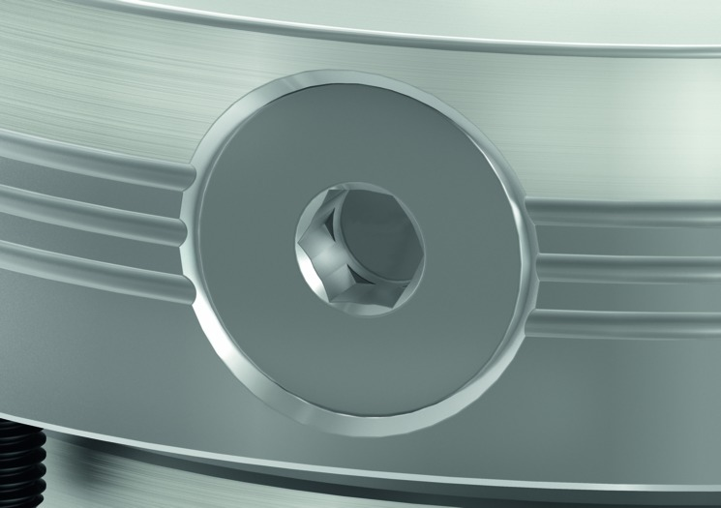
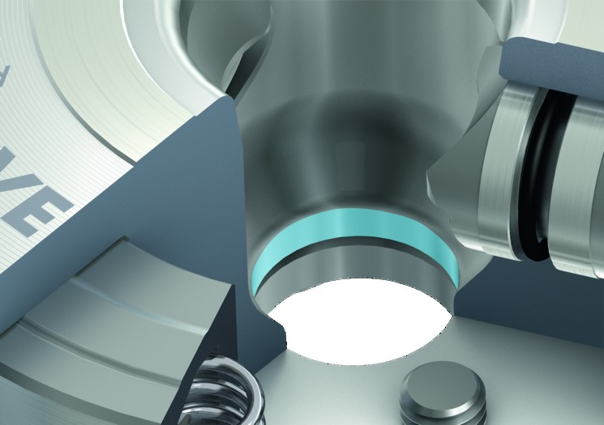
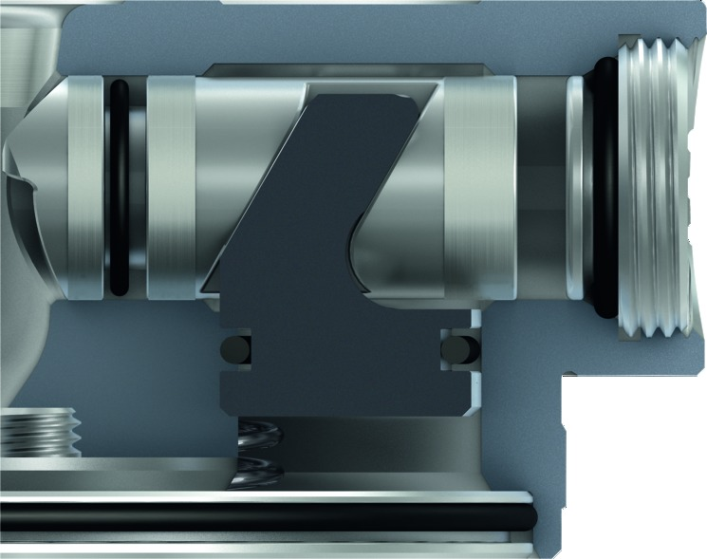
VERO-S-HT mini
Highlights
Completely sealed clamping slide bore
A locking screw on the clamping slide bore seals the system completely. Advantage: No ingress of the very fine metal powder, chips, dust or coolants in other applications.
Alignment fit in the body
A Ø 12H7 fit in the center allows the alignment of a clamping station by means of positioning elements directly on the clamping module. Clamping stations can be designed flatter.
Wedge hook drive
Provides a maximum force in any position. Advantage: Even if fine metal powder gets into the cutting area, the clamping slides do not block. The module clamps reliably.

Slide 11
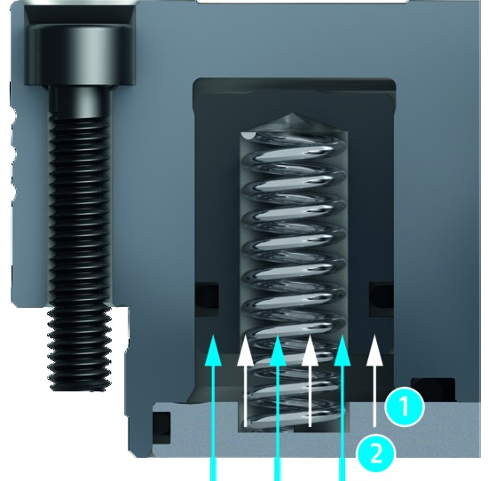
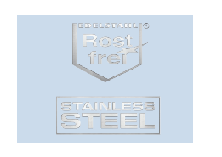
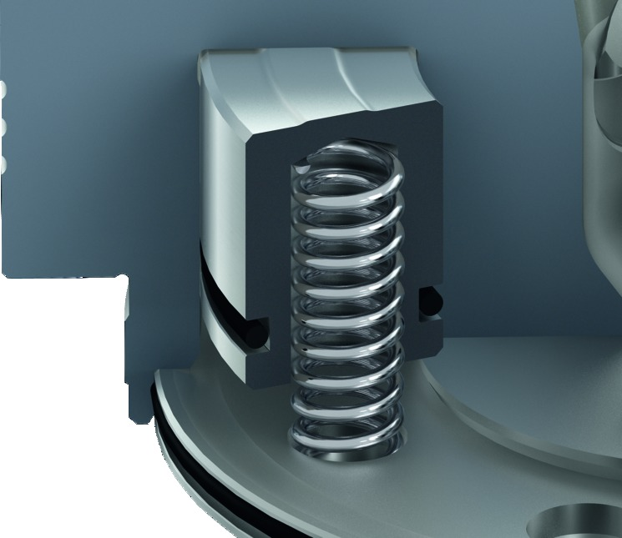
VERO-S-HT mini
Highlights
1
Spring force
2
Additional force
1
2
Integrated turbo function
In order to raise the pull-down force, the quick-change pallet module is additionally pressurized with compressed air during clamping. Due to the turbo function the pull-down force increases by the factor of 5 (max. 2,500 N) compared to clamping merely based on spring force.
Made of stainless steel – long service life
All functional components are made of hardened stainless steel.
Corrosion and high-temperature resistant pressure springs
For a maximum life span, all the actuating springs are made of fatigue-free stainless steel. Special springs have been selected, which operate without loss of performance even under continuous temperature load.

Slide 12
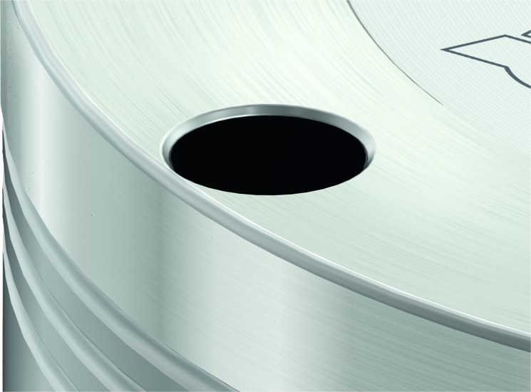
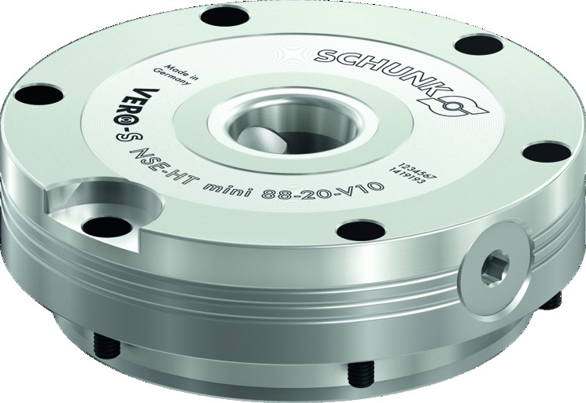
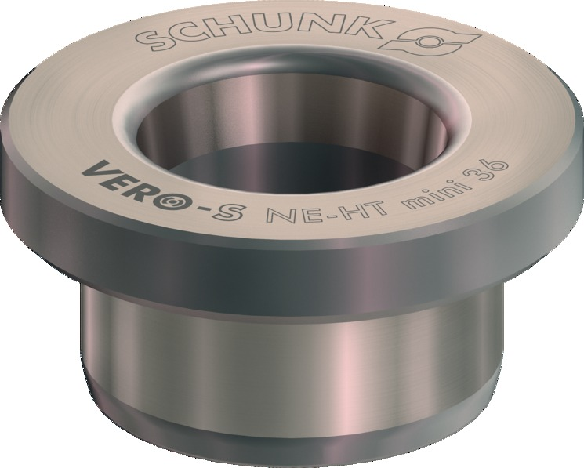
VERO-S-HT mini
Highlights
Cover caps for fastening screws
High-temperature resistant cover plugs prevent the accumulation of powder nests and other contamination.
Integrated anti-twist protection
The module NSE-HT mini 88-20-V1 is equipped with an anti-twist protection V1. The indexing pin can be additionally secured with a screw to prevent it from falling out of the fitting bore. Indexing pin remains securely joined even in the event of a large thermal expansion of the fitting.
NE-HT
If a pull-down can be dispensed with, the NE-HT centering element is used. The short taper centering is identical to the zero point clamping system. Temperatures of up to 500 °C are also possible here.

