Slide 1
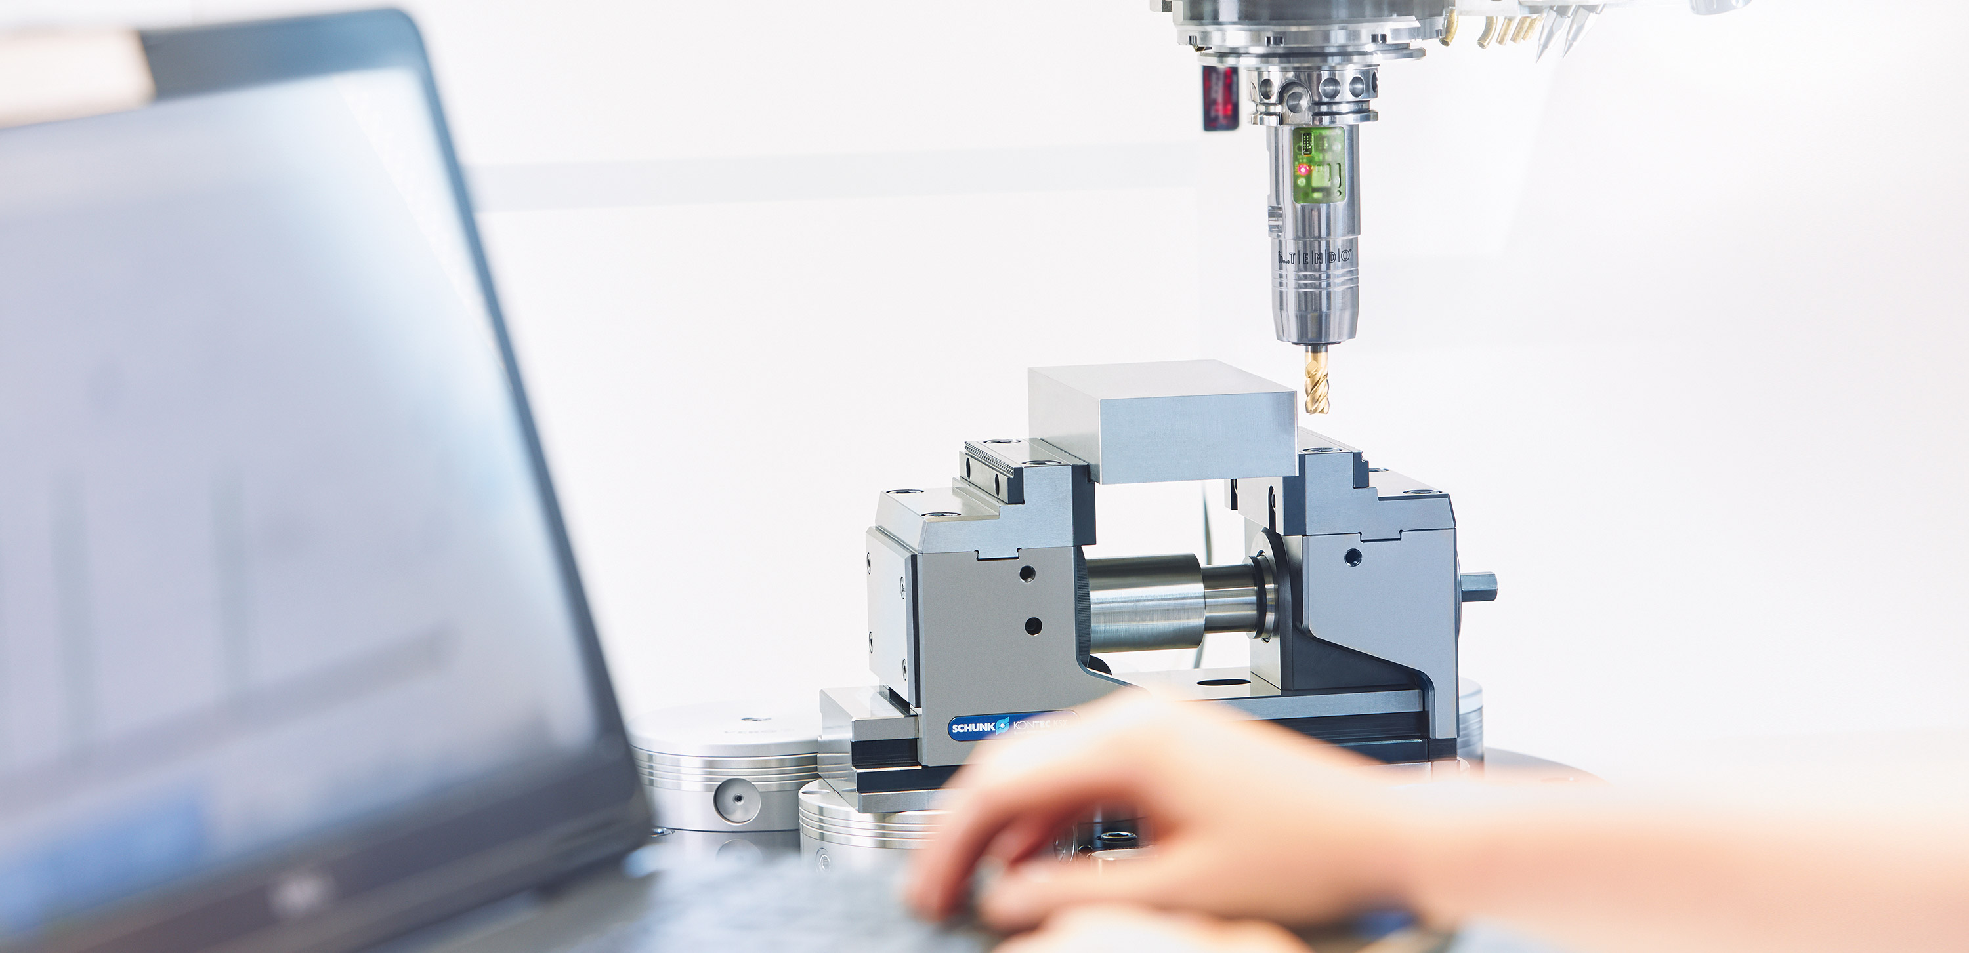
TENDO^{TURN}
Hydraulic expansion clamping technology for turning / milling centers

Slide 2
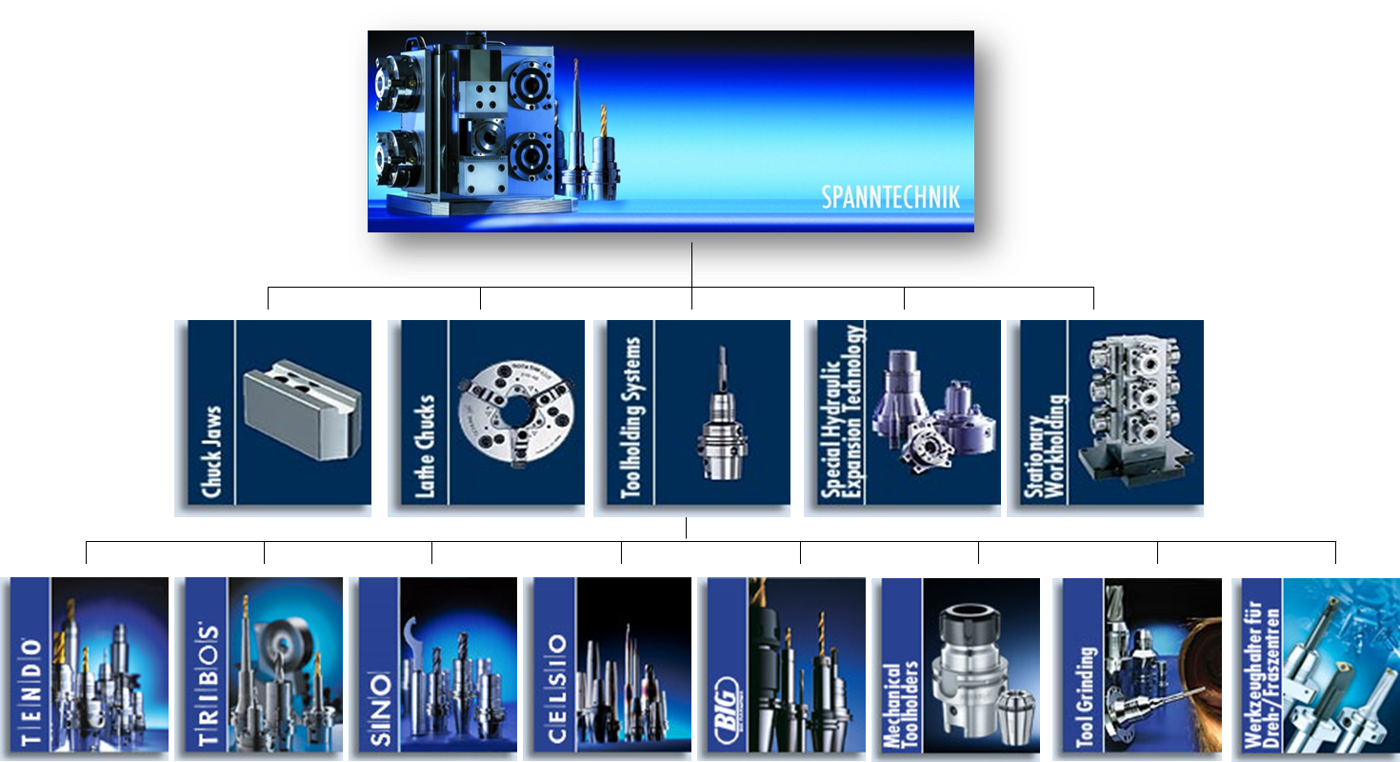
Product overview

Slide 3

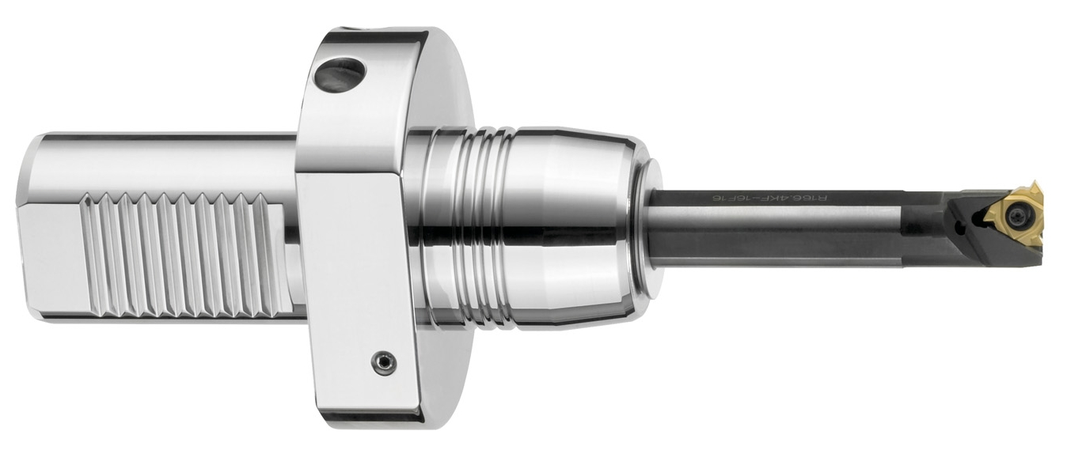
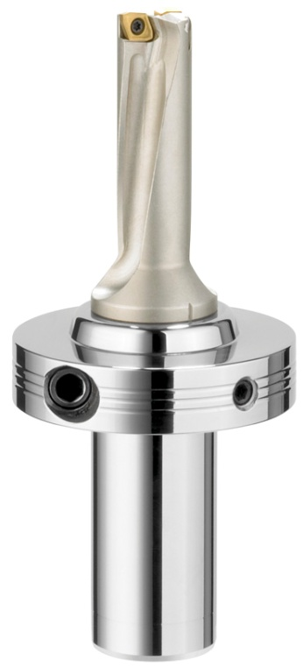
TENDO^{TURN}
Technical Highligths:
- Vibration damping
- Quick preadjustment
- Easy handling and tool change in seconds
- Compatible and universally applicable
- Flexible clamping range due to intermediate sleeves

Slide 4
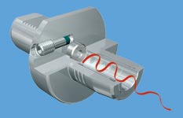
TENDO^{TURN} optimal vibration damping
Due to the hydraulic system, TENDOturn has excellent vibration damping.
Machining-induced vibrations are perfectly damped with TENDOturn, thus micro-blowouts on the cutting edge are avoided and the tool service life result is significantly increased.
Thus, a significantly better surface quality is achieved. In addition, longer projection lengths of turning fixture and boring bars are possible.

Slide 5
TENDO^{TURN} Features
Fast presetting
Axial length adjustment screws enable convenient tool presetting.
Set-up times are drastically reduced and machine running time is significantly increased.
Compact design
Optimal utilization of the machining area of a CNC lathe
Compatible and universally applicable
TENDOturn can be combined with all common turrets or interfaces, existing equipment/ basic holder can be used
Easy handling and tool change within seconds
With a hexagonal wrench, the tool is clamped quickly and securely in no time at all
Flexible clamping range due to intermediate sleeves
Several clamping ranges can be covered by using intermediate sleeves
Available for internal coolant supply and peripheral cooling

Slide 6
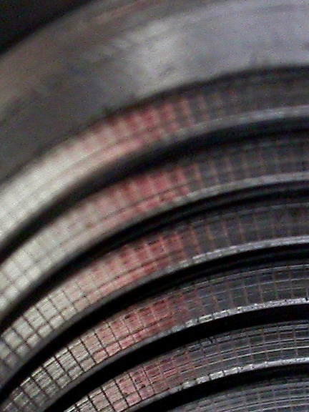
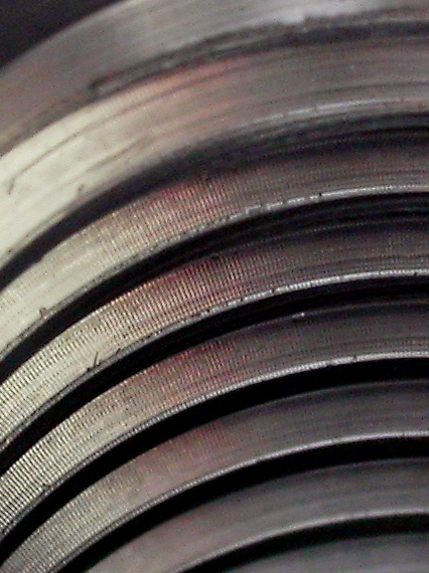
TENDO^{TURN} Practical example
Making a M24 thread
on SK 50 toolholder
VDI boring bar holder with
a threaded steel.
Result:
- Chatter marks clearly visible
- Downtime approx. 100 parts
SCHUNK DKE
clamp insert
result:
- perfect surface
- Downtime approx. 180 parts

Slide 7
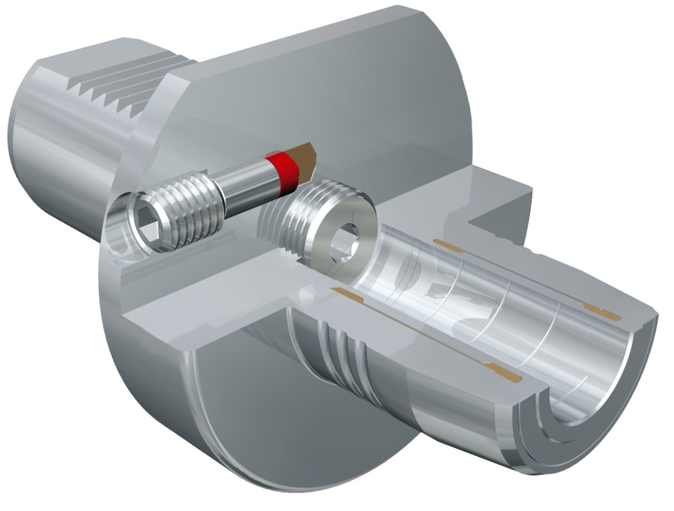

TENDO^{TURN} with VDI interface
The compact solution for direct mounting in the turret of the lathe, naturally with hydraulic expansion technology from the market leader.
Suitable for internal coolant supply and additionally equipped with axial length adjustment screw for convenient tool presetting outside the machine.
Available with the interfacesVDI-25, VDI-30 or VDI-40.
All commercially available shank types can be clamped
Coolant-proof

Slide 8
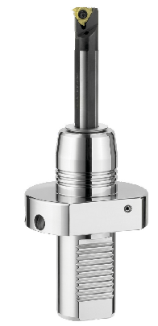
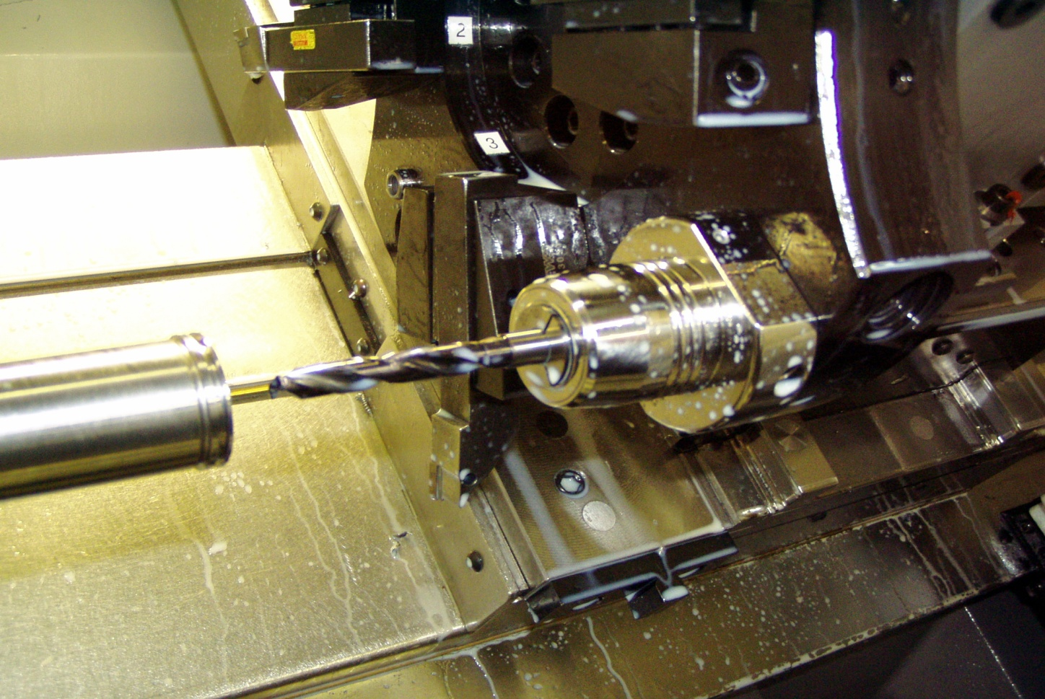

TENDO^{TURN} Application VDI 40
TENDOturn VDI 40 Ø20 mm
Drilling application VHM twist drill with cooling channel

Slide 9
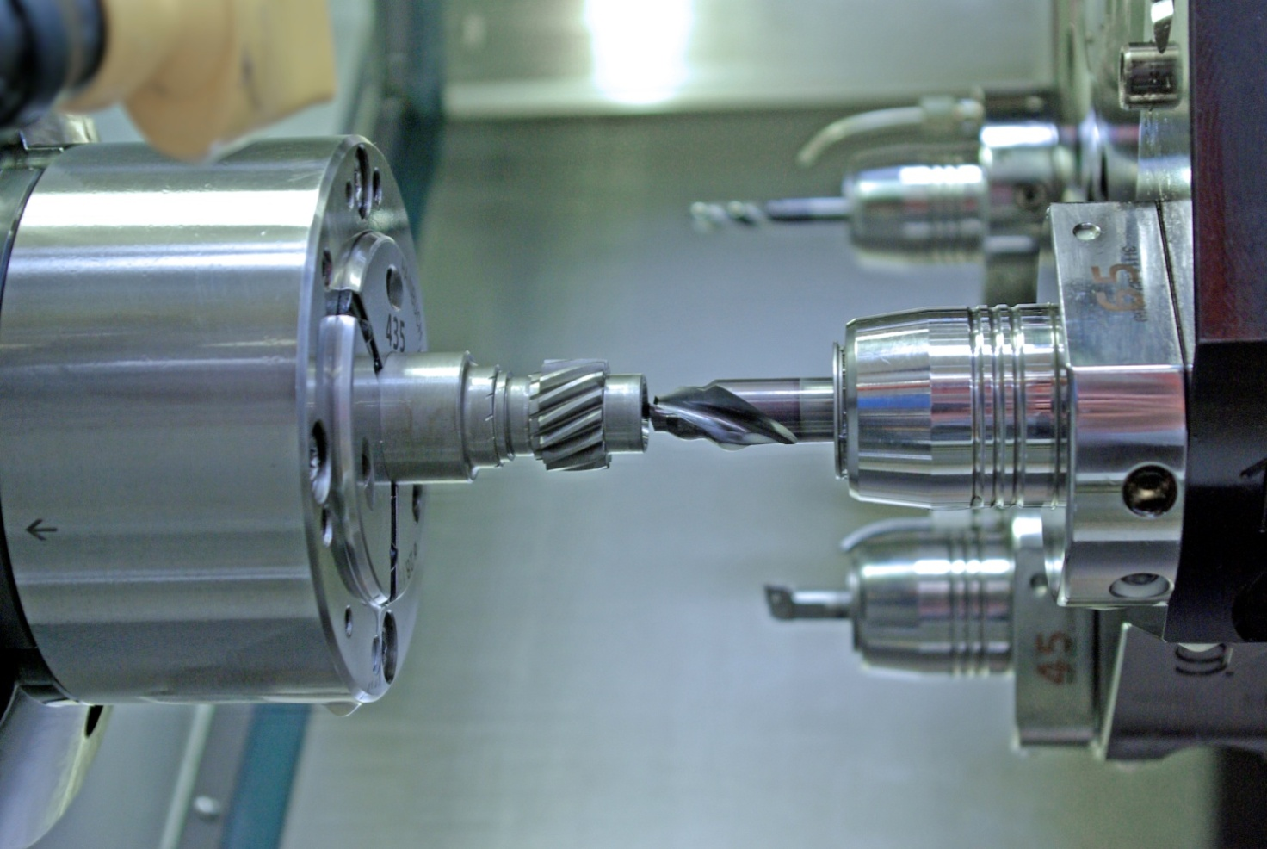

TENDO^{TURN} Customer application VDI 40
TENDOturn is used at ZF-Lenksysteme for drilling
in the field of hard turning

Slide 10
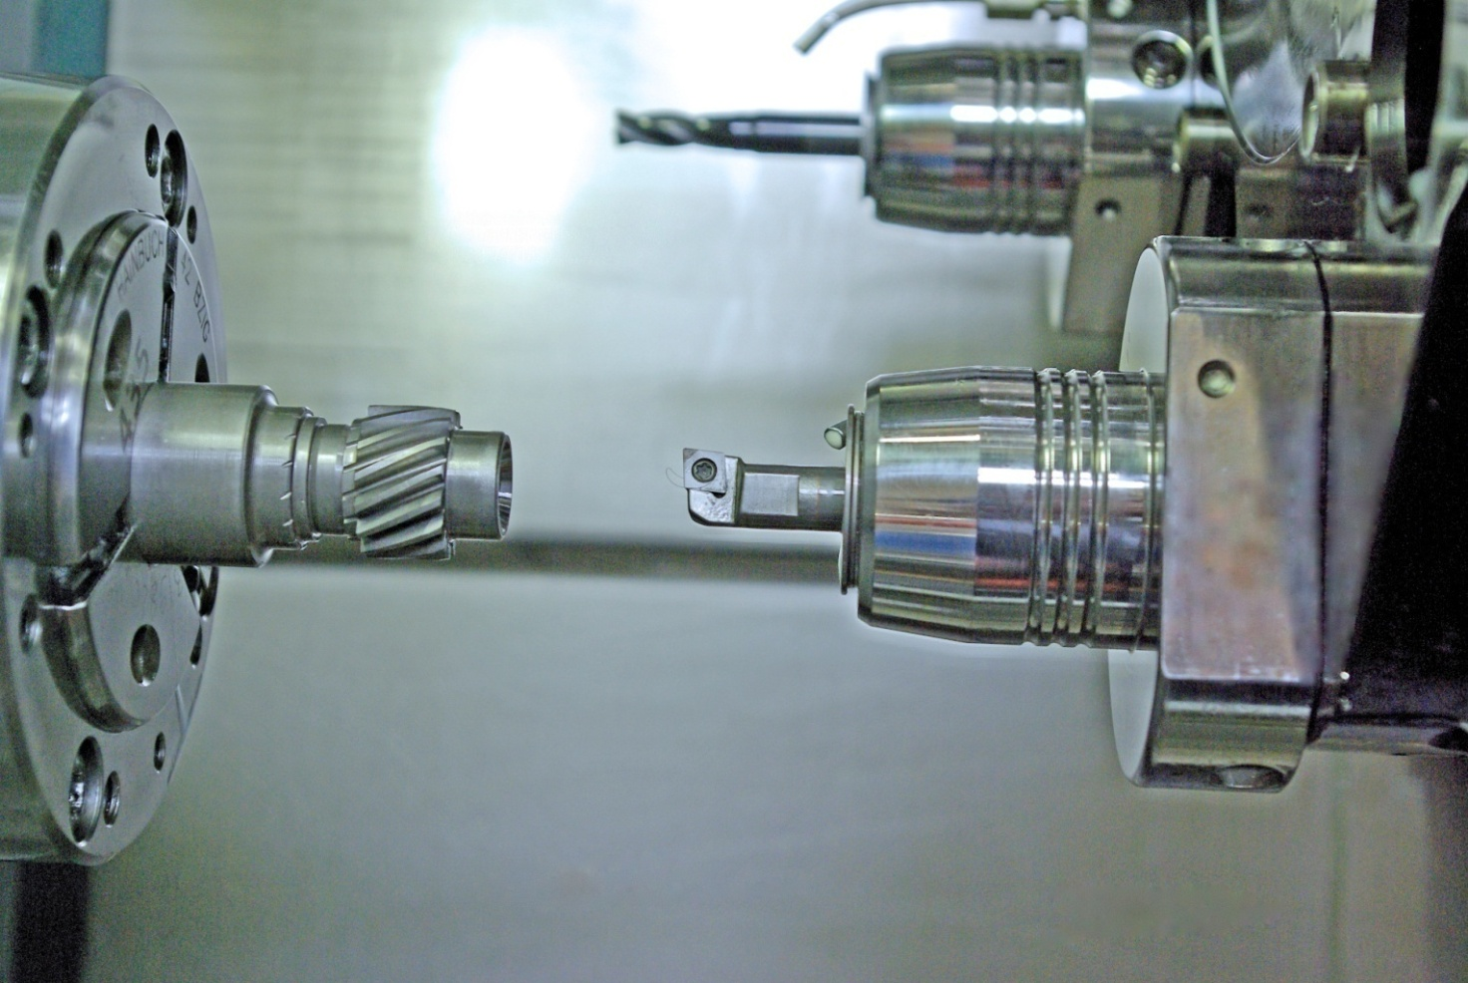
TENDO^{TURN} Customer application VDI 40
Highest precision, excellent surface quality, low tool wear and minimal setup times are convincing arguments

Slide 11
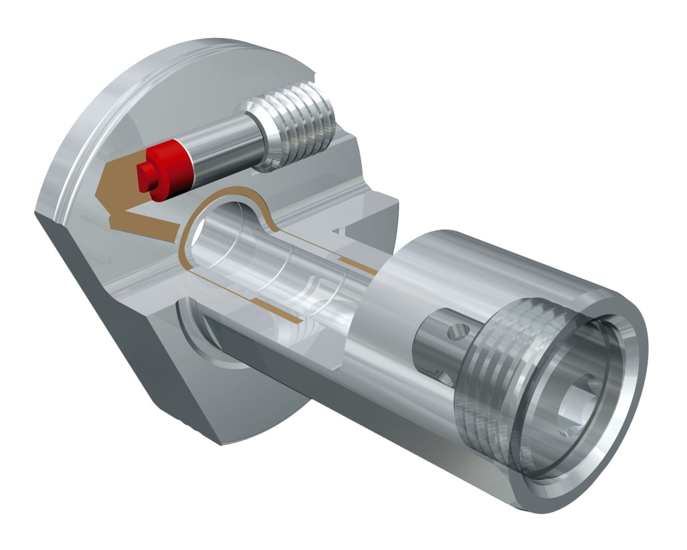
TENDO^{TURN} Lathes Clamping Insert DKE
Increase the productivity of your existing equipment by using the lathes clamping insert DKE.
TENDOturn DKE does not rely on any specific interface and can be accommodated in any standard VDI boring bar holder to absorb vibrations that occur.
For standard VDI boring bar holders,
no specific interface required, perfect vibration damping, all standard shank types can be clamped

Slide 12
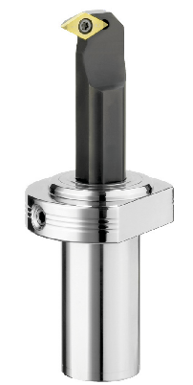
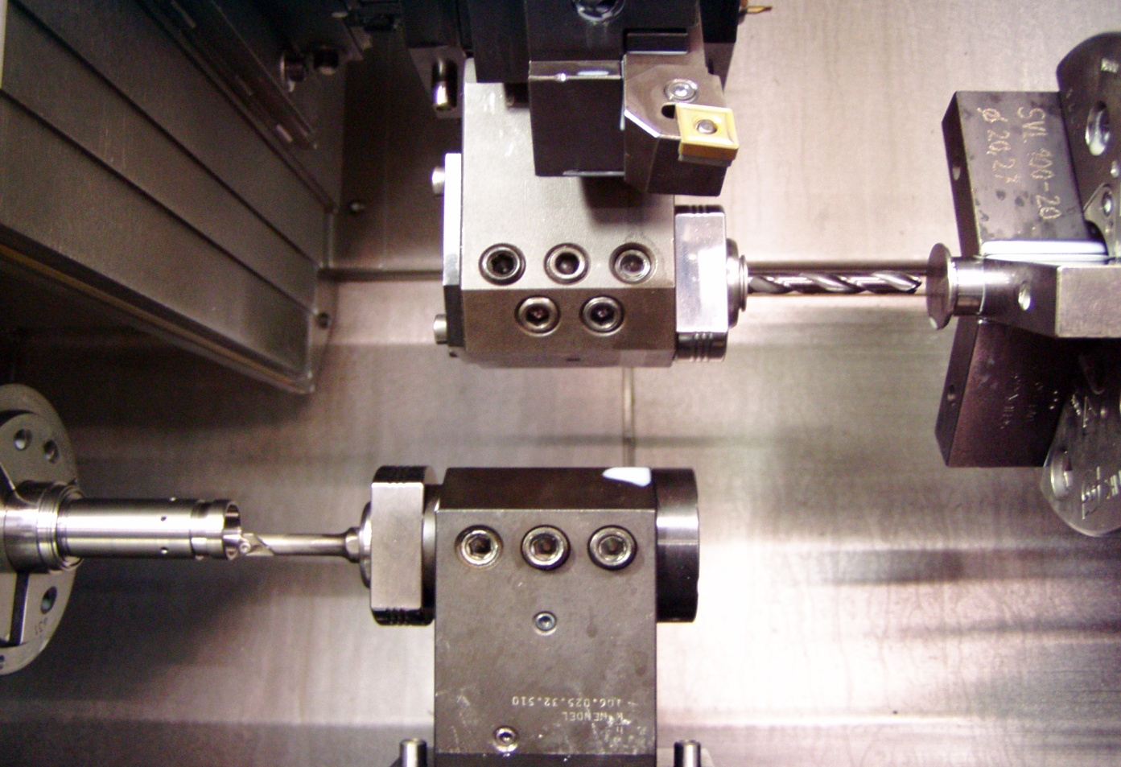
TENDO^{TURN} Application VDI 40
TENDOturn DKE
Use in VDI boring bar holder on compact double spindles

Slide 13
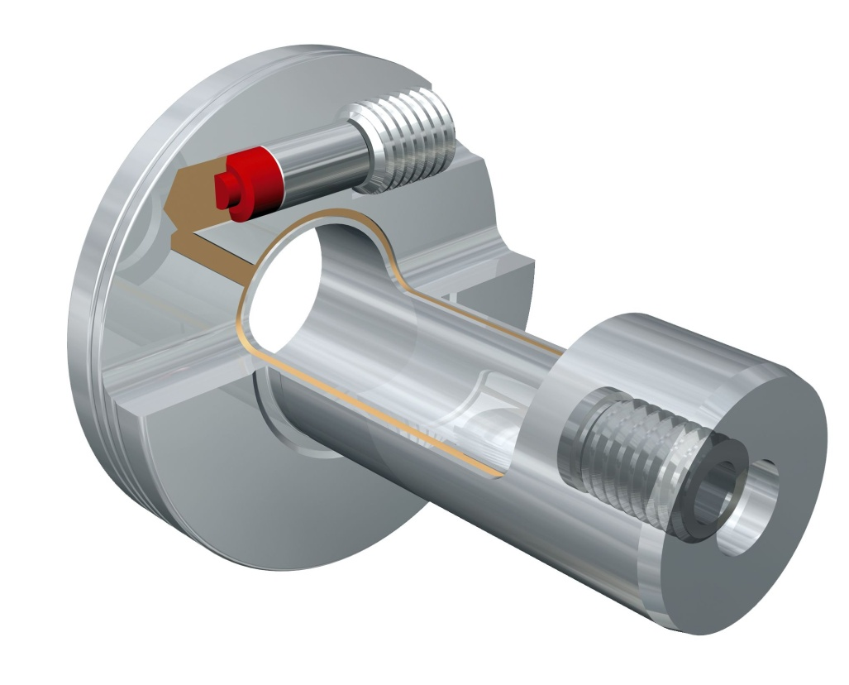
TENDO^{TURN} Double Clamping Insert DSE
Modular insert for driven tools, for perfect performance on existing equipment.
Maximum run-out quality and great vibration damping ensure optimal results. The uniform I.D. and O.D. clamping centers the insert providing maximum holding forces and correct and precise clamping of your tool.
All commercially available tool shank types can be clamped, no specific interface required ,vibration damping

Slide 14
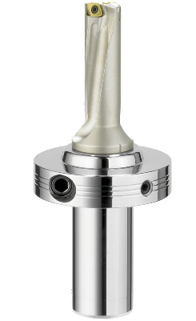
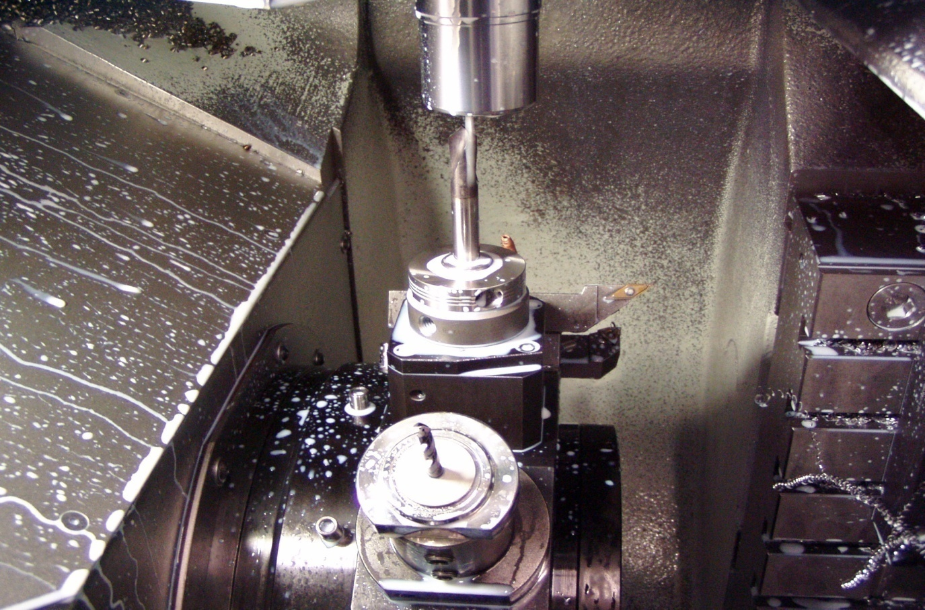
TENDO^{TURN} Application DSE
TENDOturn DSE
Clamped on driven toolholders with NC centering tool in vertical machining centers

Slide 15
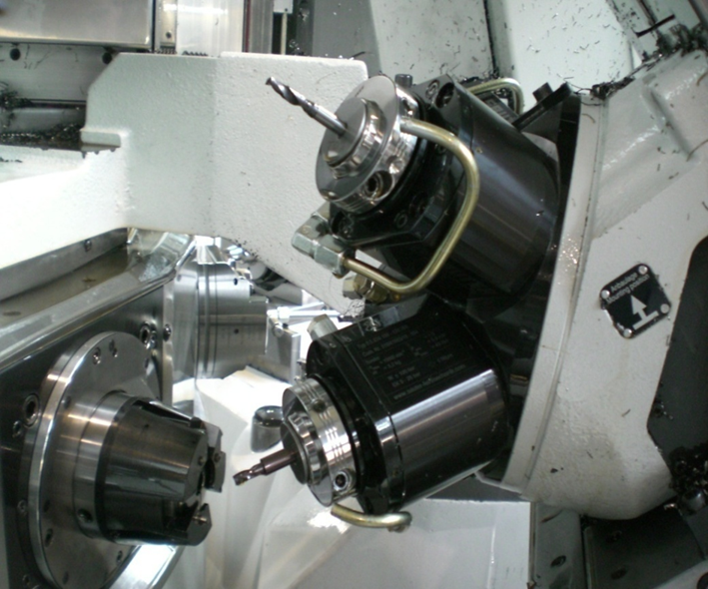
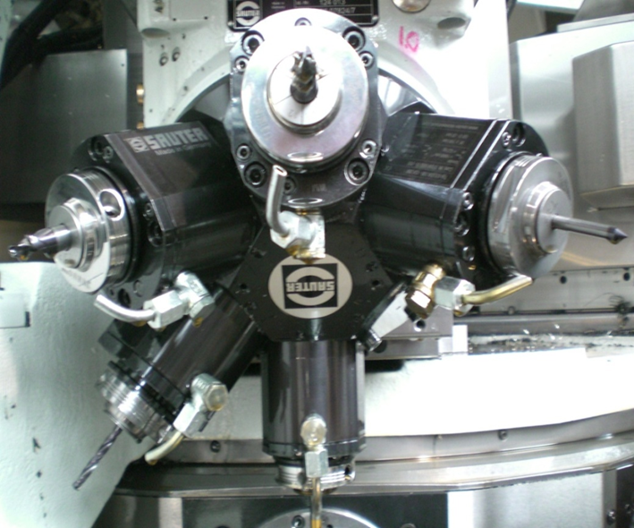
TENDO^{TURN} Application DSE
TENDOturn DSE
Application example tool crown turret for CNC rotary transfer centers

Slide 16
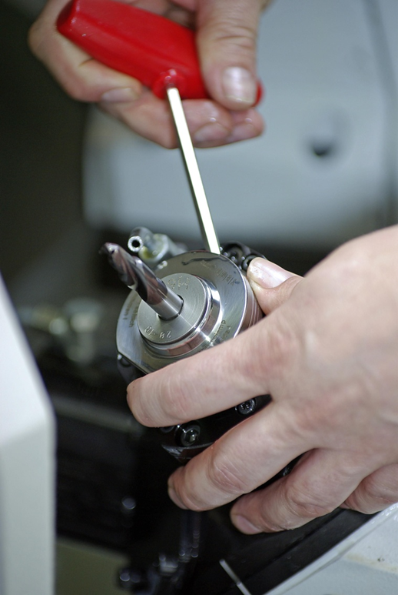
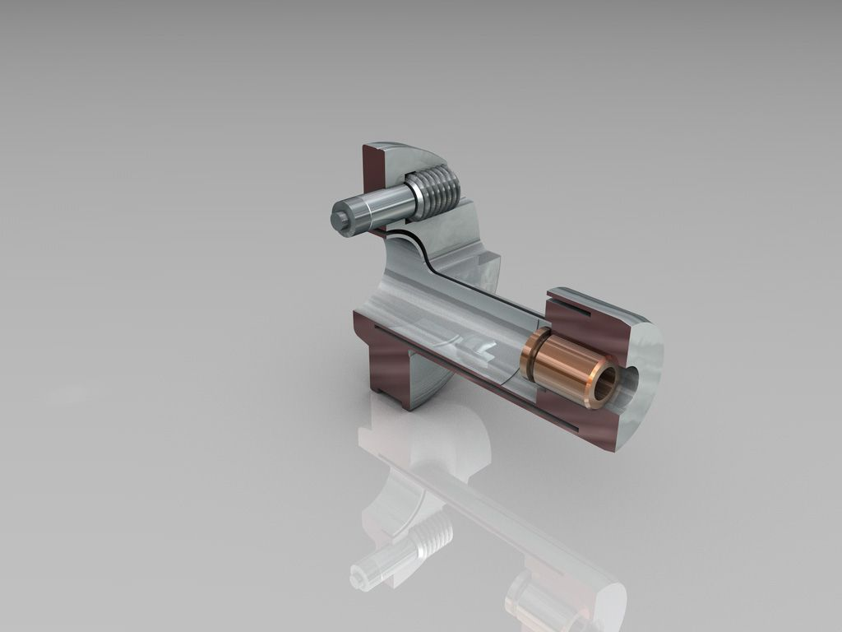
TENDO^{TURN} DSE
With TENDOturn, tools can be clamped absolutely securely and precisely in a matter of seconds
DSE - cross section

Slide 17
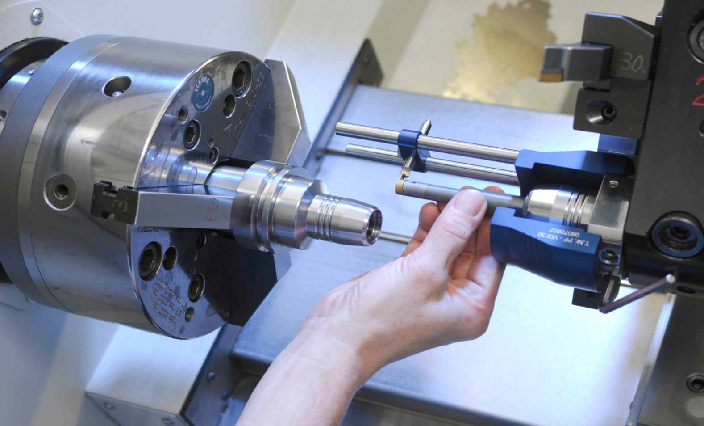
TENDO^{TURN} Aligning device
Alignment device for setting the tip height / center height
Easy operation, for best results
Available for all three VDI interfaces
VDI 25 / VDI 30 / VDI 40

